Slide 1

CALD Assist
Overcoming language barriers
in health care
Presenter's Name
Title
Meeting
Date

Slide 2
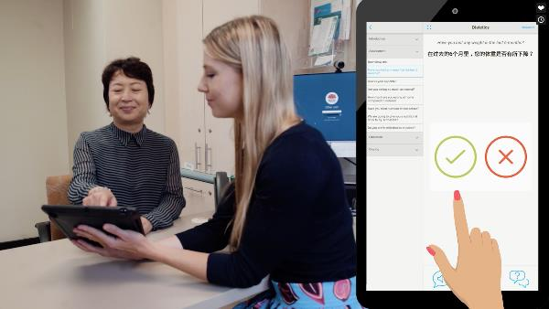
What is CALD Assist?
CALD Assist is a free communication app to support patient care. It is clinician initiated and led.
Helps health professionals communicate with patients with low English proficiency, in low risk/basic care interactions.
Developed for nursing and allied health staff in hospital settings by Western Health Victoria and CSIRO.

Slide 3
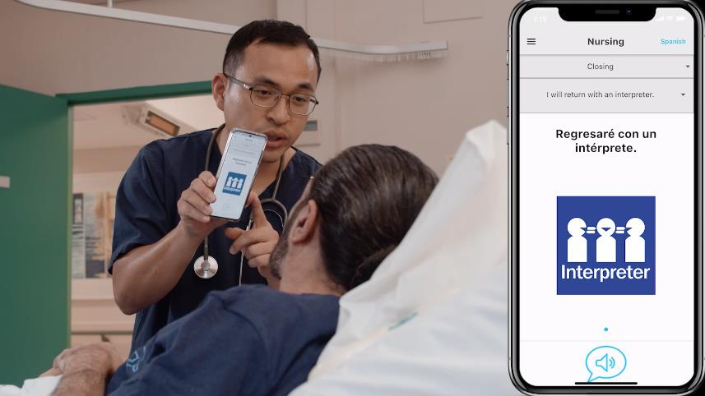
Use in NSW
Endorsed for use in NSW by Ministry of Health
Doesn’t rely on automated translation (such as Google Translate) which is not supported by NSW Health policy
Supported by Health Care Interpreter Services
Training and support materials available at: www.mhcs.health.nsw.gov.au

Slide 4
Features
Over 250 commonly used phrases in low risk/basic care interactions.
Questions and phrases divided into six discipline areas as well as COVID-19.
There is a search function to find relevant phrases.

Slide 5
Features
Professionally translated into ten languages, plus English.
Professional interpreters should still be used for:
  complex or high risk situations where more than a yes/no or multiple choice response is required
  the patient needs to ask a question.

Slide 6
Features
Translated phrases supported by images, video and audio recordings, voiced by professional interpreters

Slide 7
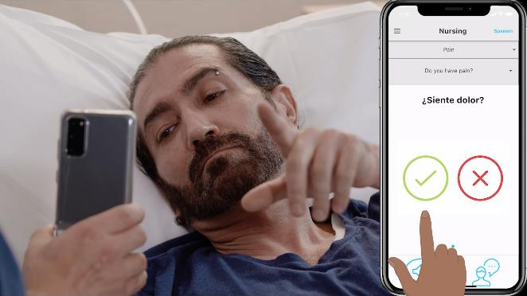
Benefits
Easy to use
Supports low risk/basic communication
No privacy issues – doesn’t store patient responses
Once downloaded, doesn’t require Wi-Fi connection
Evaluation in Victoria demonstrated:
  Interactions with patients from non-English speaking backgrounds rated as more successful
  Increased confidence in patient’s understanding
  Lower levels of staff frustration

Slide 8
Downloading CALD Assist
Available for free on iPads, iPhones and Android devices
Can be downloaded from Apple App store and Google Play store.
Staff should seek their manager’s approval before using CALD Assist to communicate with patients.
For LHD/SHN owned devices, staff should comply with their LHD/SHN policies before downloading the app.
Smart devices should be thoroughly cleaned before and after use.
More information available at www.mhcs.health.nsw.gov.au

Slide 9

Feedback from NSW
“The Cantonese speaking patient and his wife that I used this with loved it. She stated that she wished it would have been available for them at the start of his admission. They have interpreters but only for the important things. It seems that having translations for the ‘everyday’ life in a hospital is welcomed.”
Health professional at St George Hospital
during user testing in NSW

Slide 10
Resources
For more information and resources about CALD Assist www.mhcs.health.nsw.gov.au
  Resources include:
    Video
    General factsheet
    Technical guide
    Presentation template
Any questions please contact:
SESLHD-CALDAssist@health.nsw.gov.au

Slide 11
Acknowledgements
Developed by Western Health Victoria in association with the CSIRO and supported by the Victorian Government Technology Innovation Fund and Better Care Victoria.
Training resources for NSW Health staff have been funded by the Health and Social Policy Branch, NSW Ministry of Health.

