Slide 1
[Insert name of LHD]
Notes:
Slide notes:
These templates are meant to be customised by LHDs with relevant information. If you would like support to add/adjust images, please contact Charlotte Burns in the CINSW communications team. The images in this presentation can be used by districts, and districts may also add their own slides/images to build on this information.
You may wish to record a voiceover/narration with slide timings to create a video. For instructions, see here: https://support.microsoft.com/en-us/office/record-a-slide-show-with-narration-and-slide-timings-0b9502c6-5f6c-40ae-b1e7-e47d8741161c.

Slide 2
About Multicultural Health Week
The aim of the MHW to raise awareness of health issues experienced by culturally and linguistically diverse communities and ways to address these issues.
Notes:
Script:
Since 2009, NSW Health has held Multicultural Health Week to raise awareness of health issues experienced by culturally and linguistically diverse communities and how to address these issues.

Slide 3




About [Insert name] LHD
NSW is proudly multicultural. In NSW, an average of 34.5% were born overseas.
[Insert statement/s about LHD demographics.]
Total population: [LHD to insert]
People who speak a language other than English at home: [LHD to insert]
People born overseas: [LHD to insert]
People who do not speak English well or at all: [LHD to insert]
Notes:
Script:
We celebrate the diversity of New South Wales and our multicultural district.
[Insert commentary re LHD stats]
Slides:
District to use Census data/demographic data about profile of relevant area cultural & language diversity, e.g.
https://quickstats.censusdata.abs.gov.au/census_services/getproduct/census/2016/quickstat/125?opendocument.

Slide 4
Top 10 languages spoken at home
In this district, the following languages are most commonly spoken in the home:
X
X
X
X
X
X
X
X
X
X
Notes:
Script:
In our district, the top ten languages spoken in homes are: XXX.
Some emerging languages include: XXX, XXX and XXX.
Slide:
Please insert stats specific to your district. Contact Multicultural Health Communications Service if you need assistance to populate.

Slide 5
The importance of cancer screening
This year’s Multicultural Health Week theme is cancer screening.
Research indicates that the earlier someone is diagnosed with cancer, the better their treatment options and overall health outcomes are likely to be.
The purpose of cancer screening is to find cancers before they cause symptoms, and when treatment is likely to be more successful. Screening is also used to find pre-cancerous lesions which can be treated to prevent them from progressing to cancer.
Notes:
Script:
Each year, there is a different theme for Multicultural Health Week. This year, we are highlighting the importance of cancer screening.
Cancer screening looks for cancers before they cause symptoms. Screening is one of the most effective ways to detect early signs of cancer. Treating cancers early can lead to better health outcomes.

Slide 6
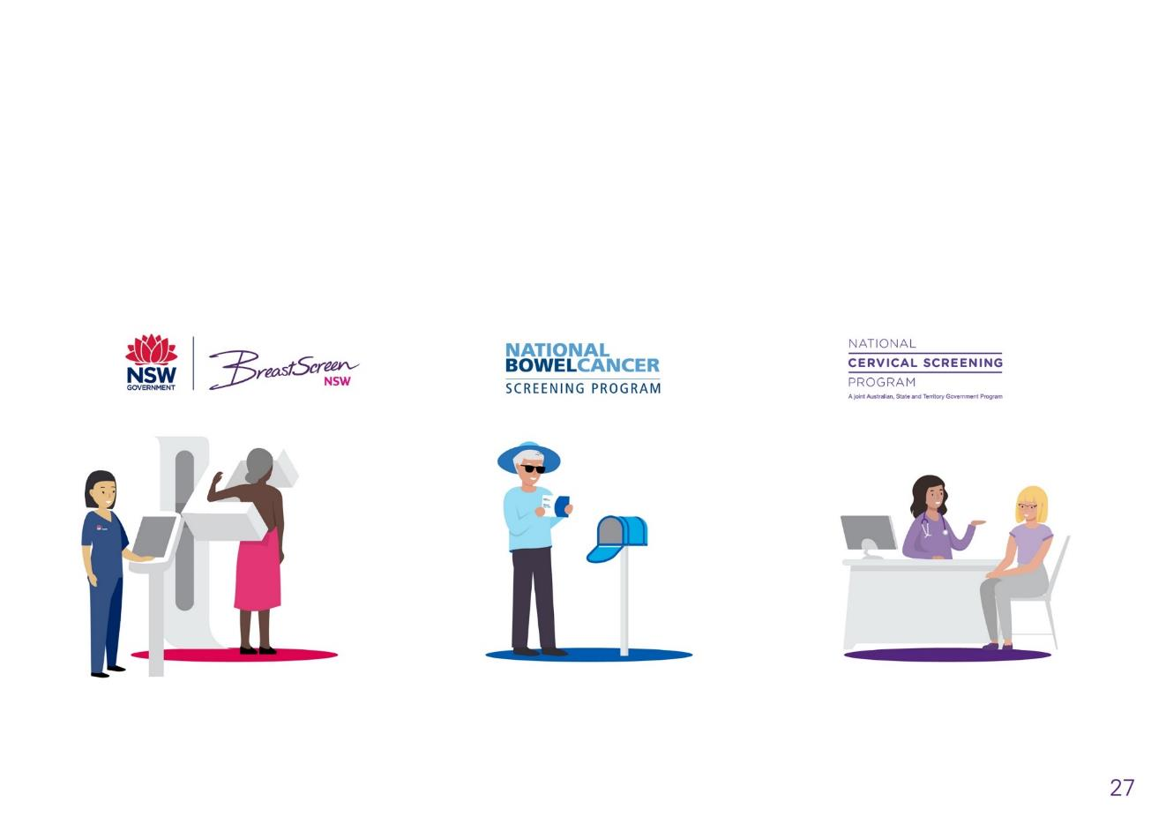

Screening programs
In Australia, there are three national screening programs.
Breast screening
Bowel screening
Cervical screening
Notes:
Script:
In Australia, the three screening programs look for breast, bowel and cervical cancers.
The goal is for all eligible people to participate in screening programs.

Slide 7
Barriers to screening
People from multicultural backgrounds can face barriers to cancer screening. Some barriers may be:
lack of awareness and information about screening
lack of health literacy
emotional barriers, such as feelings of embarrassment, shame or fear
lack of in-language information
difficulty navigating the health system.
Notes:
Script:
Screening programs are offered to different groups of people, but people from multicultural backgrounds may have some difficulties participating.

Slide 8
Breast screening participation in our district
[Insert district] is proud to invite all eligible women to participate in breast screening.
BreastScreen NSW provides free screening mammograms to women aged 50-74. Women aged 40-49 and women aged 75+ are also eligible to attend.
Notes:
Script:
BreastScreen NSW provides free screening mammograms to women aged 50-74. Women aged 40-49 and women aged 75+ are also eligible to attend.
In our district, we are pleased that certain groups of women have high levels of participation.
Slide instructions:
Following slides reference BSNSW participation rate for women aged 50-74 for the biennial period July 2019 to June 2021. Each district should request this data from the Cancer Institute NSW team by emailing CINSW-ScreeningAndPreventionData@health.nsw.gov.au.
Please note that there are some limitations to reporting data; at this stage we only report approximately 19 languages.
If you have problems requesting this data, please contact MHCS.
The LHD should then add/delete slides to highlight success stories/groups with high screening rates. It is recommended that the information be put in a plain language format (e.g. if it is 33%, One in three Turkish women….etc)
If the district films footage of someone speaking about their screening experience, they can add a slide (Layout options in this format/plain) and then embed localised video.

Slide 9
[Insert stat in simple terms – e.g. One in two/Half/50.2%] of Turkish women in [district name] participate in breast screening.

Slide 10
[Insert stat] of Vietnamese women in [district name] participate in breast screening.

Slide 11
[Insert stat] of Filipino women in [district name] participate in breast screening.

Slide 12
[Insert stat] of Arabic women in [district name] participate in breast screening.

Slide 13
[Insert stat] of Hindi women in [district name] participate in breast screening.

Slide 14
[Insert stat] of Cantonese speaking/Mandarin speaking women in [district name] participate in breast screening.

Slide 15
[Insert stat] of Maltese women in [district name] participate in breast screening.

Slide 16
[Insert stat] of Serbian/Croatian women in [district name] participate in breast screening.

Slide 17
[Insert stat] of French women in [district name] participate in breast screening.

Slide 18
[Insert stat] of Italian women in [district name] participate in breast screening.

Slide 19
[Insert stat] of Greek women in [district name] participate in breast screening.

Slide 20
[Insert stat] of Korean women in [district name] participate in breast screening.

Slide 21
[Insert stat] of German women in [district name] participate in breast screening.

Slide 22
Cervical screening
[Insert district] is proud to invite all eligible women to participate in cervical cancer screening.
Cervical cancer is one of the most preventable cancers in Australia. This is due to the success of the National Cervical Screening Program (NCSP), and the vaccination program for the human papillomavirus (HPV).
Women aged 25 to 74 years of age are invited to have a Cervical Screening Test every five years. There are two options for having the test: a doctor/nurse can collect the sample or they can explain to the person to collect their own sample.
Notes:
Script:
Cervical cancer screening provides free screening to people with a cervix aged 25-74. A cervical test is done ever five years for most people.

Slide 23
Cervical screening participation data is in the National Cancer Screening Register, which does state and national reporting.
[Insert stat for district, e.g.: In our district, one in three eligible women participate in cervical cancer screening.]
Notes:
Script:
In our district, we are pleased that women from multicultural backgrounds have high levels of participation. [LHD to insert and comment on specific info]
Slide instructions:
We don’t currently have data breakdown by language but the LHD can provide general participation rates.

Slide 24
Bowel cancer screening
[Insert district] is proud to invite all eligible people to participate in bowel cancer screening.
The National Bowel Cancer Screening Program is a Commonwealth Government‑funded program that invites people aged 50–74 years to do a free bowel screening test every two years. This test involves collecting a small sample from two bowel motions (faeces/poo), which are sent to a laboratory for testing.
Notes:
Script:
Bowel cancer screening provides free screening to people aged 50-74. A free bowel cancer screening kit is sent by post to eligible people by post.

Slide 25
Participation in our district
[Insert general stat about participation for whole district – data can be accessed in Reporting for Better Cancer Outcomes: https://www.cancer.nsw.gov.au/about-cancer/document-library/cancer-control-in-nsw-statewide-report-2020
[Insert stat for district: In our district, one in three people participate in bowel screening.]
Notes:
Script:
In our district, we are pleased that people from multicultural backgrounds have high levels of participation. [LHD to insert and comment on specific info]
Slide instructions:
We don’t currently have data breakdown by language but the LHD can provide general participation rates.

Slide 26
multiculturalhealthweek.com

