Slide 1
Healthy ageing
Multicultural Health Week 2025
Presenter Name
Presenter Title
00 Month 20YY
Notes:
Note: LHDs to input local presenter details for presentation.
Instructions for use:
Use base presentation slides for base presentation for both community and non-community audiences.
Base presentation is suitable for all audiences (Slide 1 to 14)
Closing slide (slide 24)
Depending on time and length of presentation, option to add additional information targeted to specific groups
Additional information on Healthy Ageing resources – add slides to end of section in base presentation
Exercise providers and health professions: Slide 15
Additional information on exercise directory – add slides to end of section in base presentation
Exercise providers and health professionals: Slide 16 to 19
Additional information on Get Healthy Service – add slides to end of section in base presentation
Health professionals: Slide 20 to 21
Setting the scene for health professionals – add slides to end of section in base presentation
Health professionals: Slide 22 to 23

Slide 2
Audience: general population Remove before presentation.

Slide 3
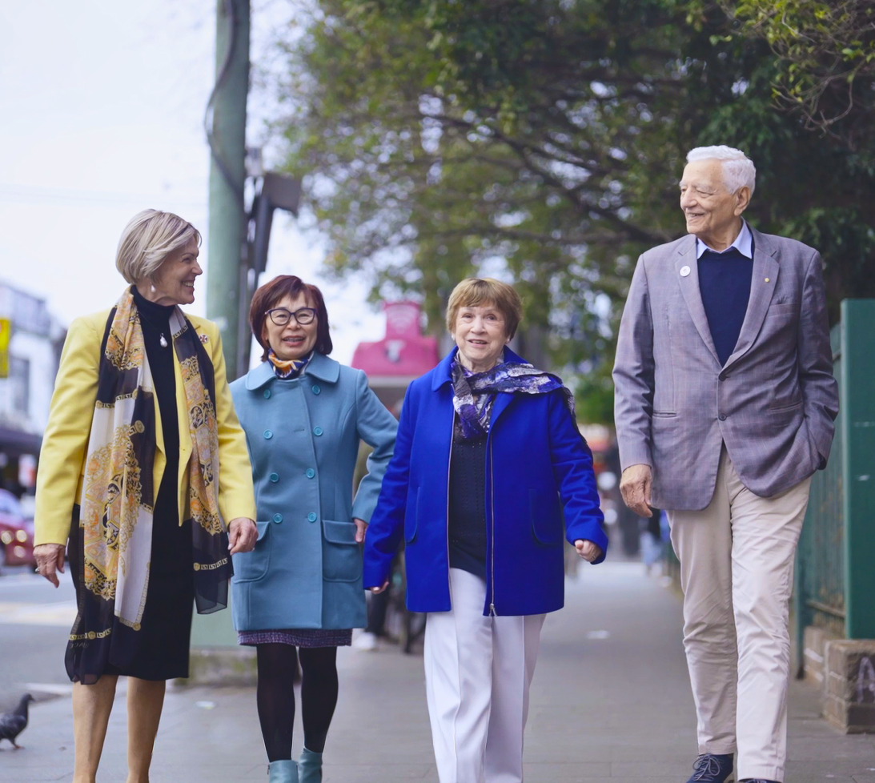
Older people are the heart of the family and community
This Multicultural Health Week, we focus on supporting older people from culturally and linguistically diverse communities to stay healthy, active and socially connected.
We understand that some multicultural communities experience higher rates of chronic health issues and cancer.
We are supporting you to access:
health information in your language
healthy ageing programs and services with language support

Slide 4
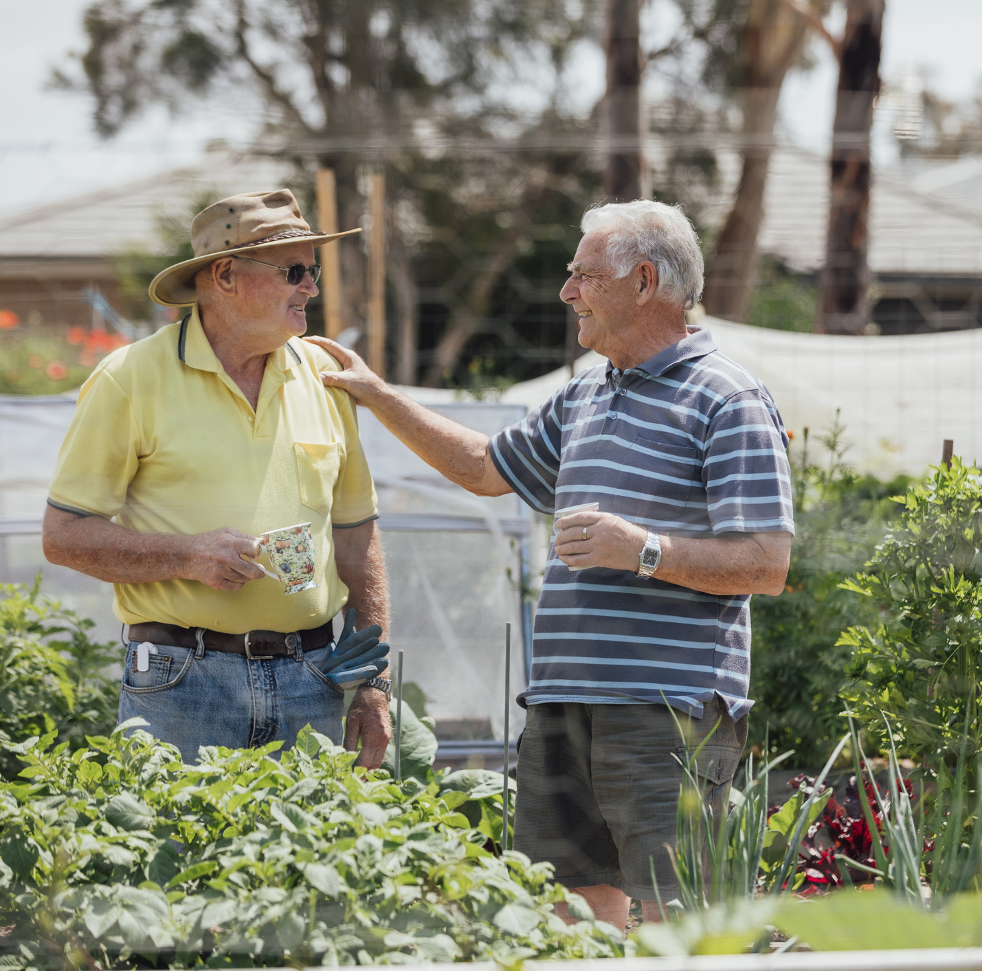






Healthy ageing
Being physically and mentally able to do the things you value and enjoy
Getting healthy and active in older adulthood can help:
Stay independent
Improve balance and prevent falls
Keep bones and muscles strong
Improve wellbeing
Reduce stress
Improve sleep

Slide 5
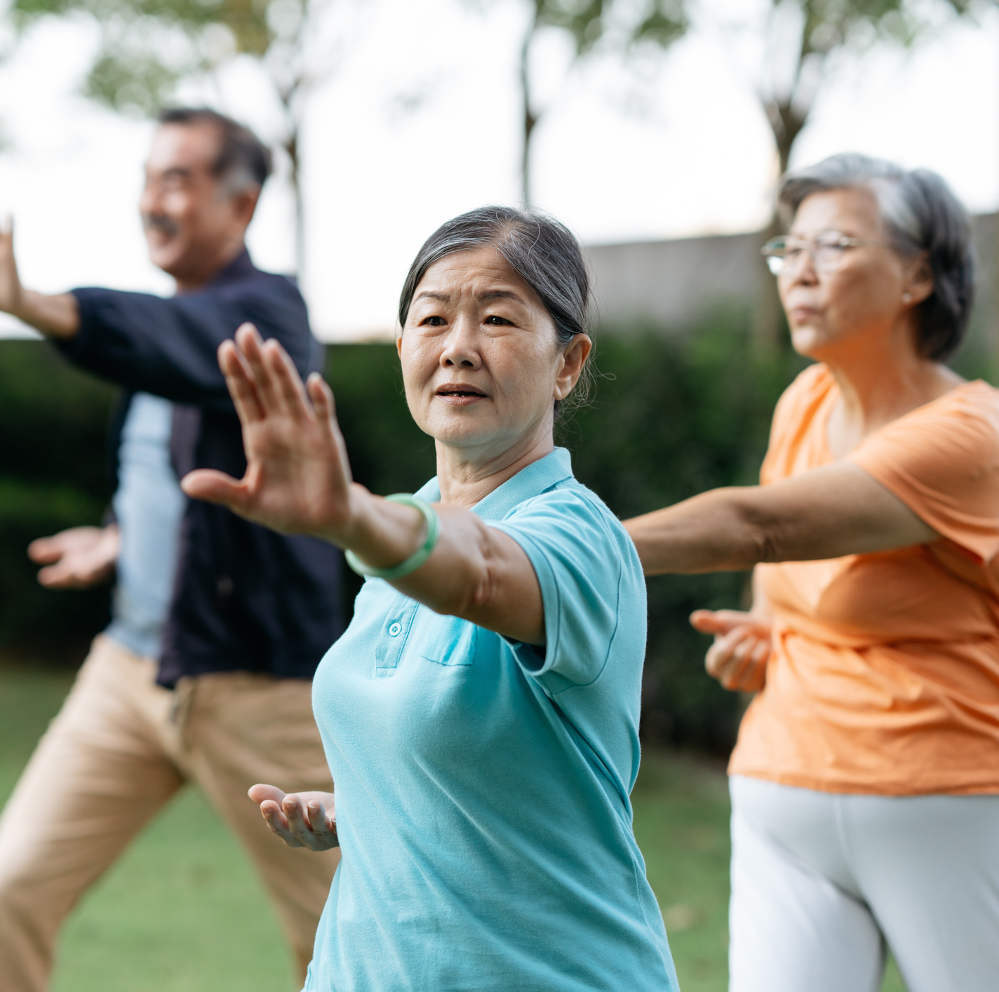



Free healthy ageing support
NSW Health has free support to help you live healthy and active lives and stay independent for as long as possible
Online learning
Exercise directory
Health coaching
Fact sheets and exercise manual

Slide 6
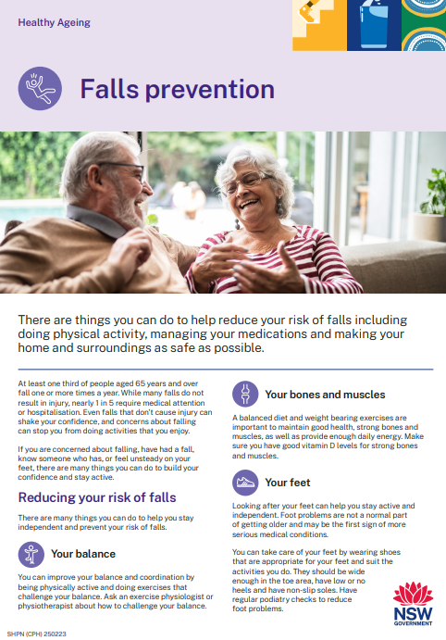
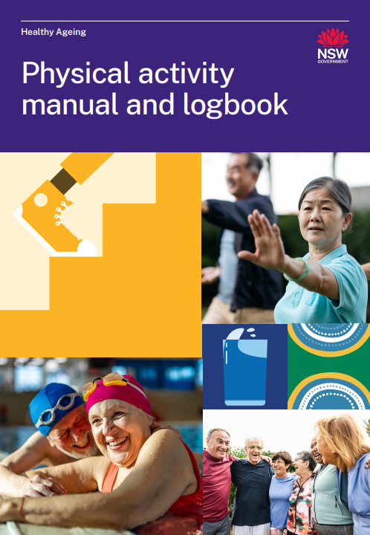


Healthy ageing resources
Free healthy lifestyle and physical activity resources for older people
Learn about healthy eating, getting active and falls prevention from the comfort of your own home.
You can access:
Online learning topics with quizzes
Exercise videos for beginners
Access the free resources:
activeandhealthy.nsw.gov.au/active-living/healthy-ageing-resources
Helpful resources including fact sheets and an physical activity manual.*
*Also available in the following languages: Arabic, Chinese Simplified, Chinese Traditional, Greek and Italian
Learn at your own pace. Each module takes 10 to 15 minutes to complete.
Notes:
Key points:
The online learning will teach you about healthy eating, getting active and falls prevention at your own pace from the comfort of your own home.
The free resources include:
8 learning topics with quizzes
2 online exercise circuits for beginners
17 fact sheets with helpful tips and information and
A physical activity manual and logbook
Fact sheets and physical activity manual has been translated into Arabic, Chinese Simplified, Chinese Traditional, Greek and Italian
Participants can find the healthy ageing resources by clicking on “Healthy Ageing resources” page on the Active and Healthy homepage.

Slide 7

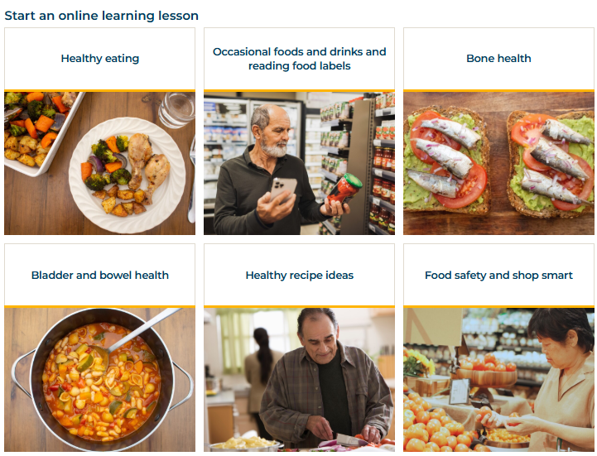









Healthy ageing resources
Choose from eight online learning topics:
Healthy eating
Food labels
Bone health
Bladder and bowel health
Learn at your own pace. Each topic takes 10 to 15 minutes to complete.
Healthy recipe ideas
Food safety
Oral and eye health
Falls prevention

Slide 8
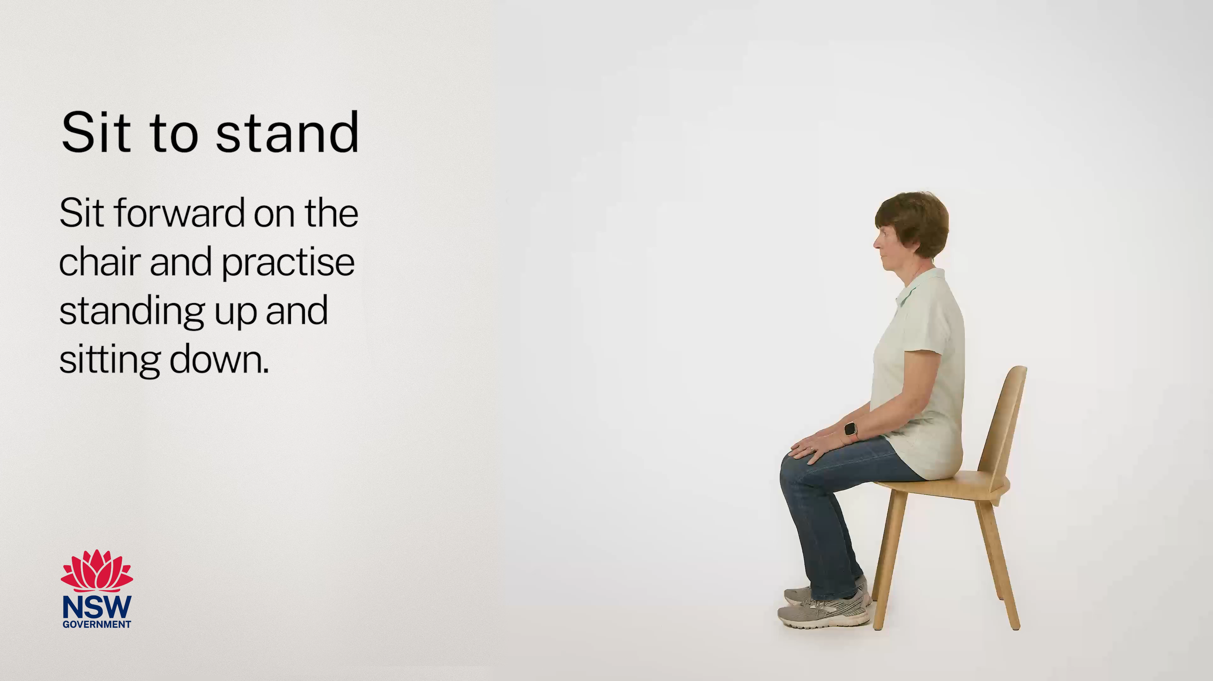

Example exercise circuit
Notes:
Note: Click the speaker image to start audio when playing the slide.
Additional slide to use to showcase exercise circuit.

Slide 9
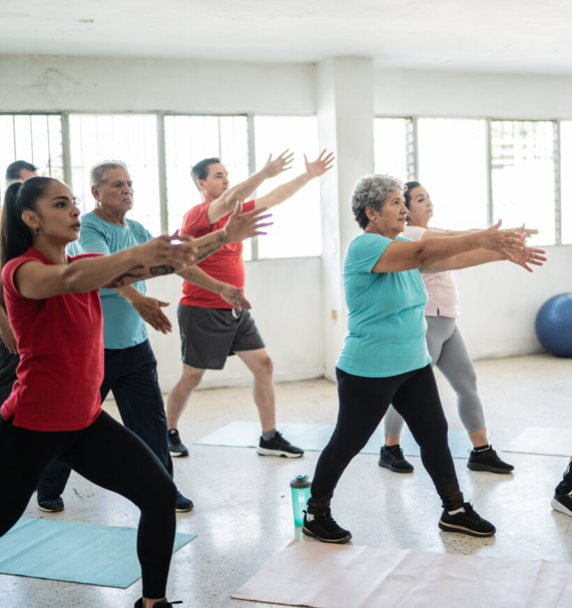
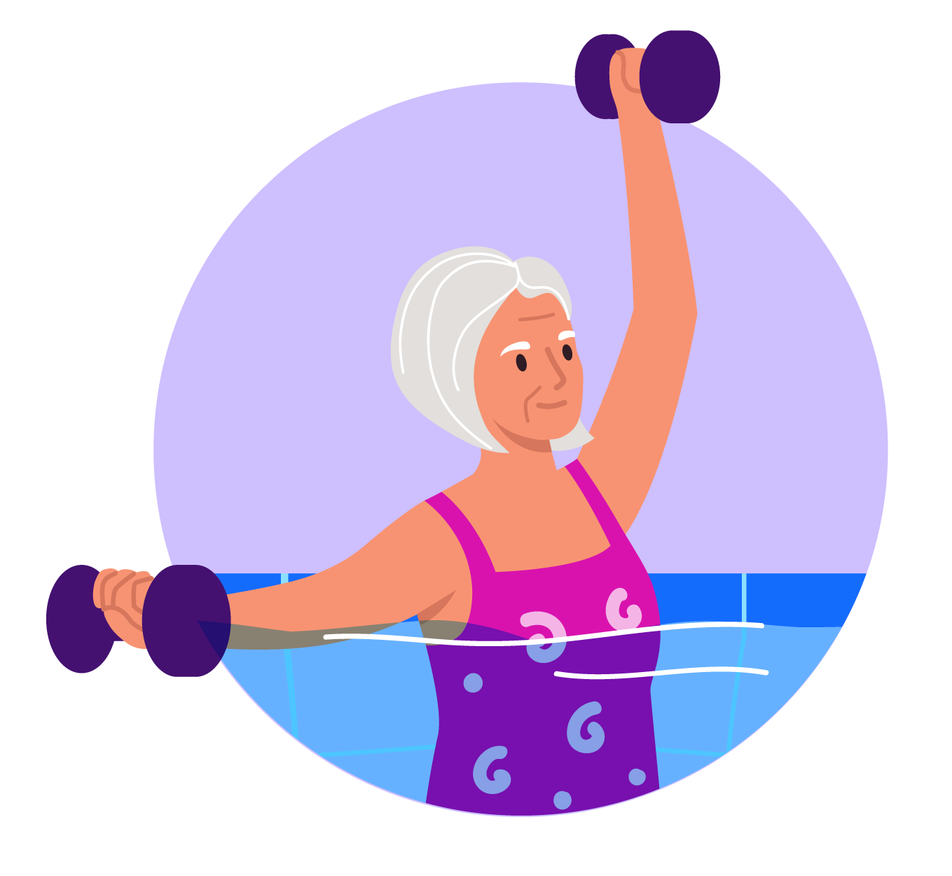
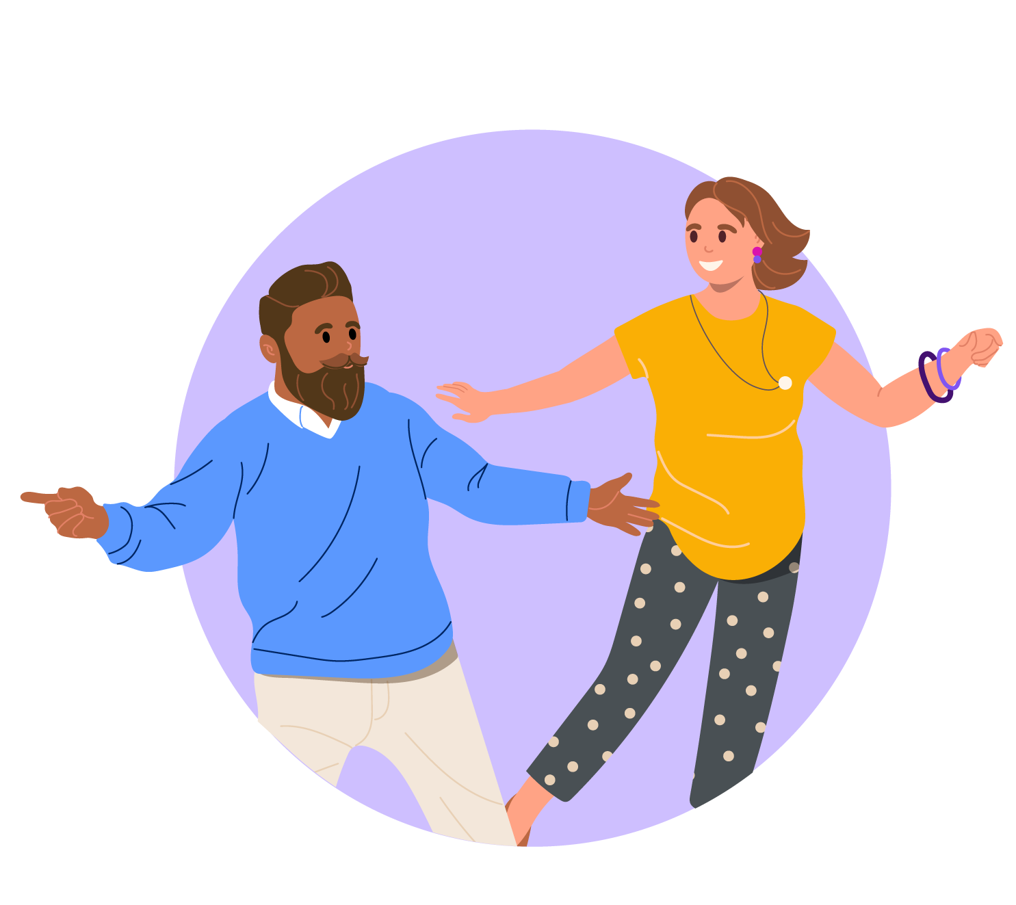
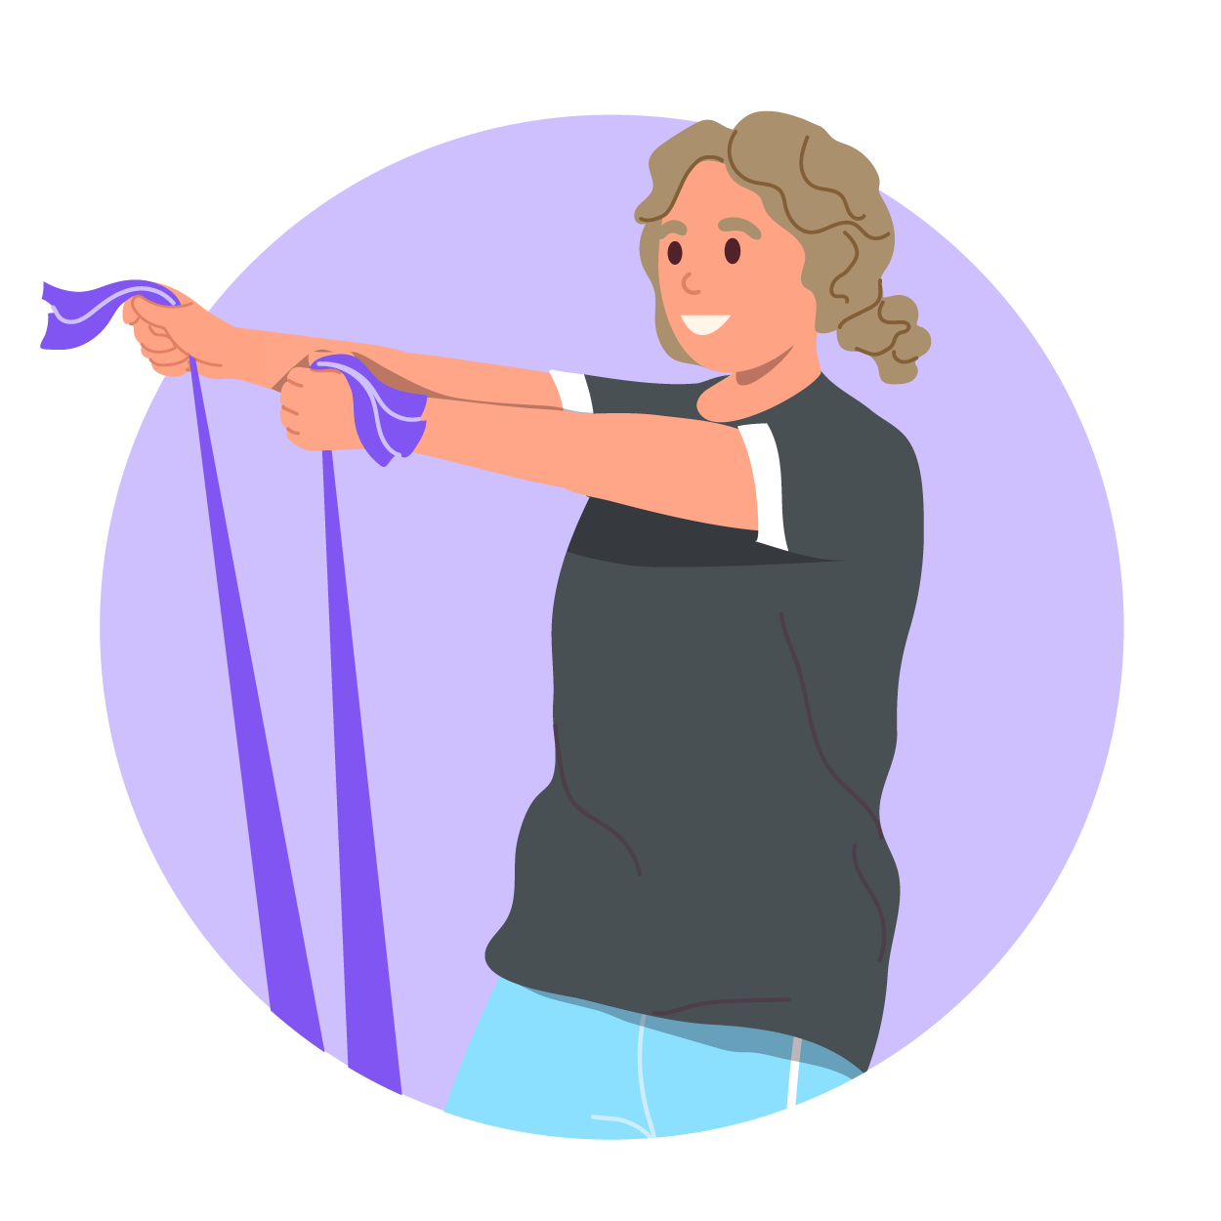
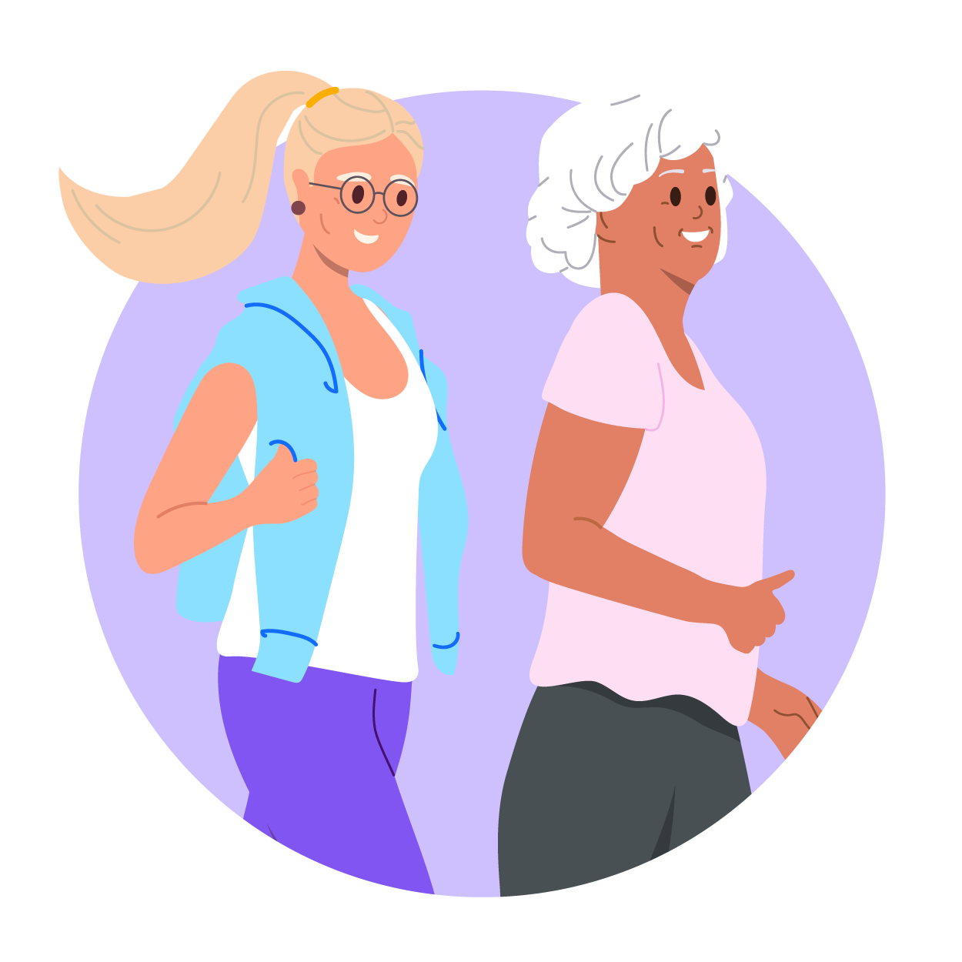
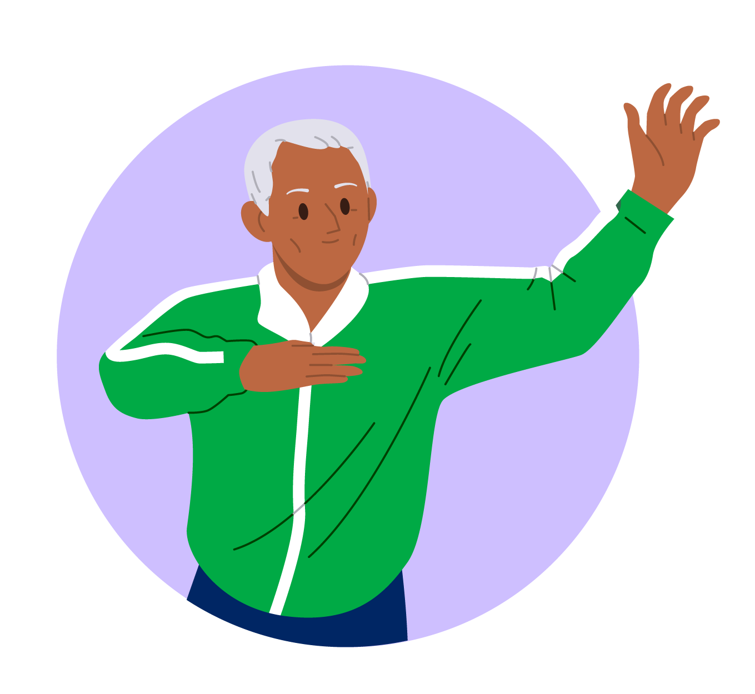
Active and Healthy exercise directory
Find local physical activity and falls prevention programs for over 50s.
Joining a class online or in the community is a great way to get active, stay healthy and make friends along the way.
Use the Active and Healthy directory find an exercise program in your local area or virtual program. Classes include:
Water exercise
Dance classes
Strength training
Walking groups
Tai chi

Slide 10

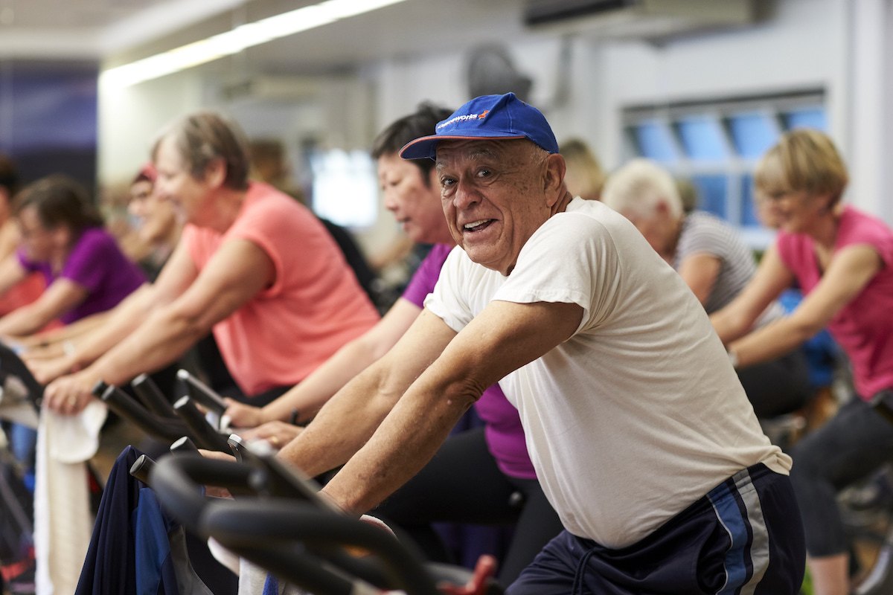
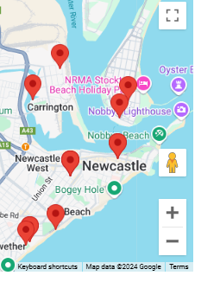




Find programs near you
Where
Program type
When
Get started:
activeandhealthy.nsw.gov.au/find-a-program
Cost
Notes:
Map can be replaced so it is relevant to LHD location.
Ungroup image of tablet and map
Replace screenshot of map with one relevant to LHD and crop/resize image to fit within tablet.
Ensure tablet image is laying on top of map image.
Group images together

Slide 11
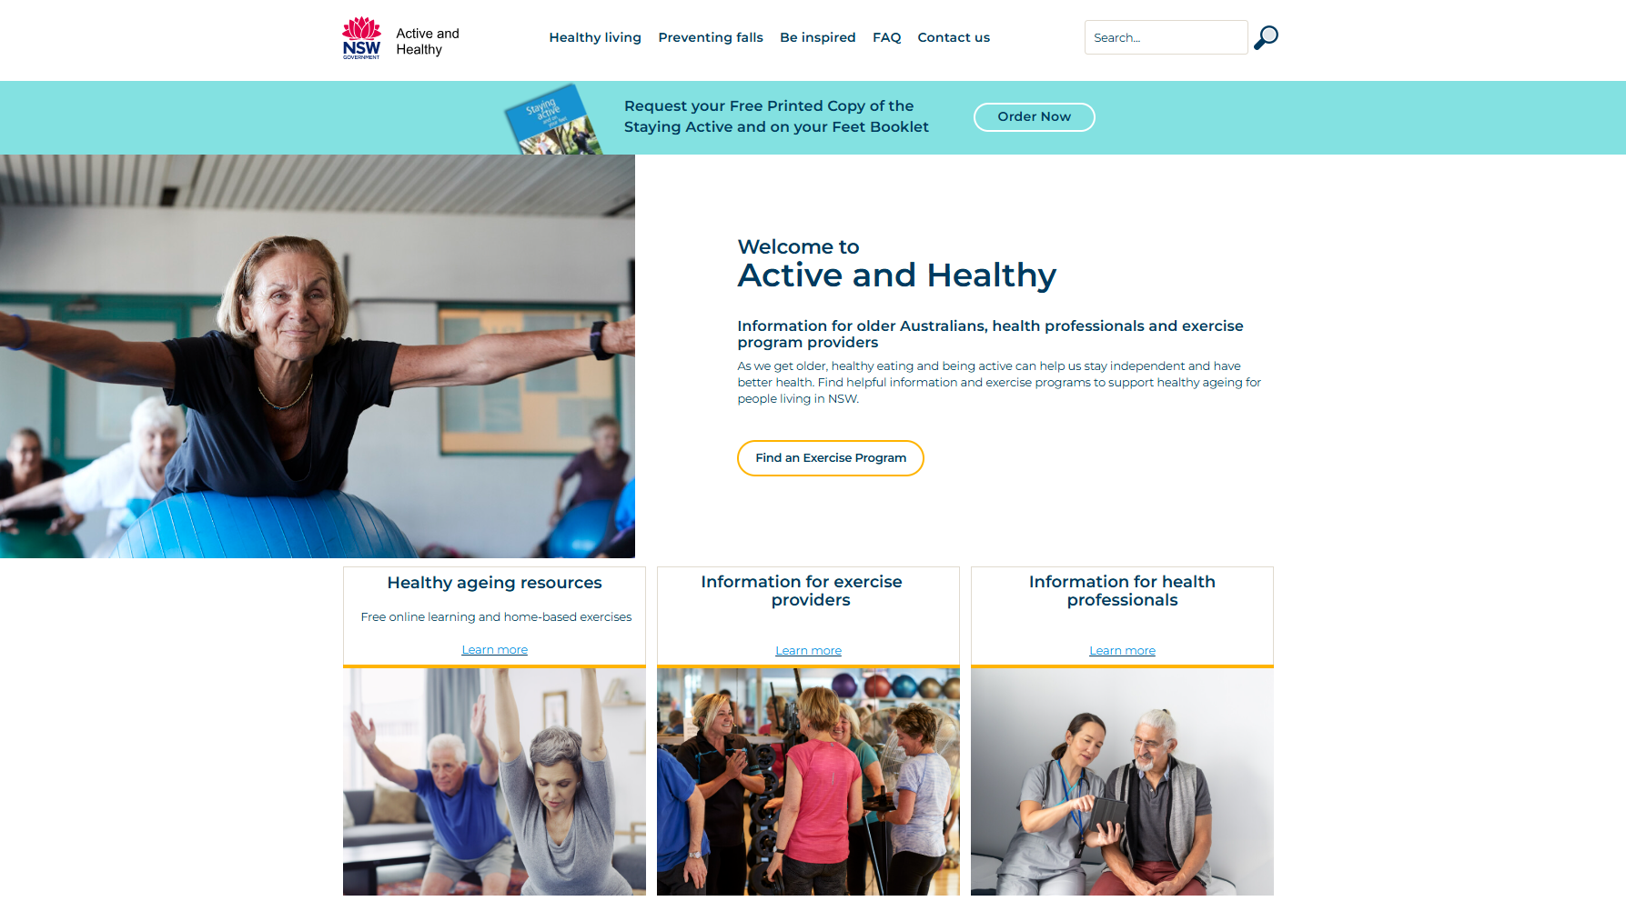
How to navigate the Active and Healthy Website
Notes:
Youtube link: https://www.youtube.com/watch?v=N1pOPYsB4Dg&feature=youtu.be

Slide 12
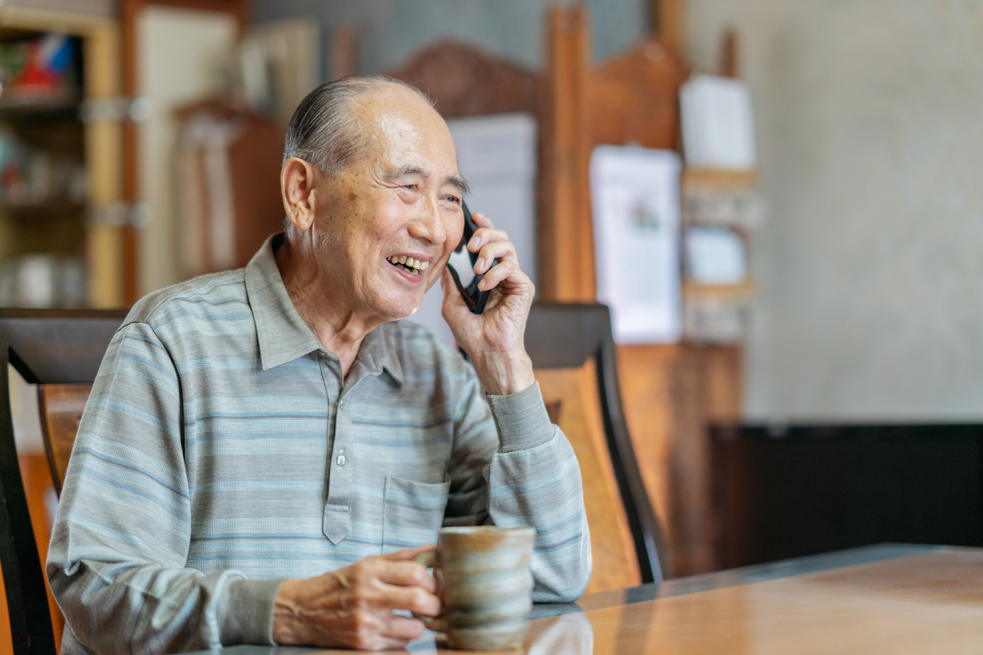





Get Healthy Service
Free online and phone health coaching service for people over 16 living in NSW.
A health coach can help you to:
Receive up to 10 phone or online calls with your health coach to set and achieve your own health goals.
Aboriginal health coaches, bi-lingual health coaches, interpreter services and the National Relay Service are available.
Develop
healthy eating habits
Stay physically active
Improve strength and balance to reduce your risk of falls
Drink less alcohol
Manage or lower your risk of diabetes and other chronic health conditions
Get started today
Ask your health professional
Call 1300 806 258
Visit the website gethealthynsw.com.au
Notes:
Key Points
- Older adults can join the Get Healthy Program while they complete the Healthy Ageing online learning topics to receive further support as they work through the resources.

Slide 13
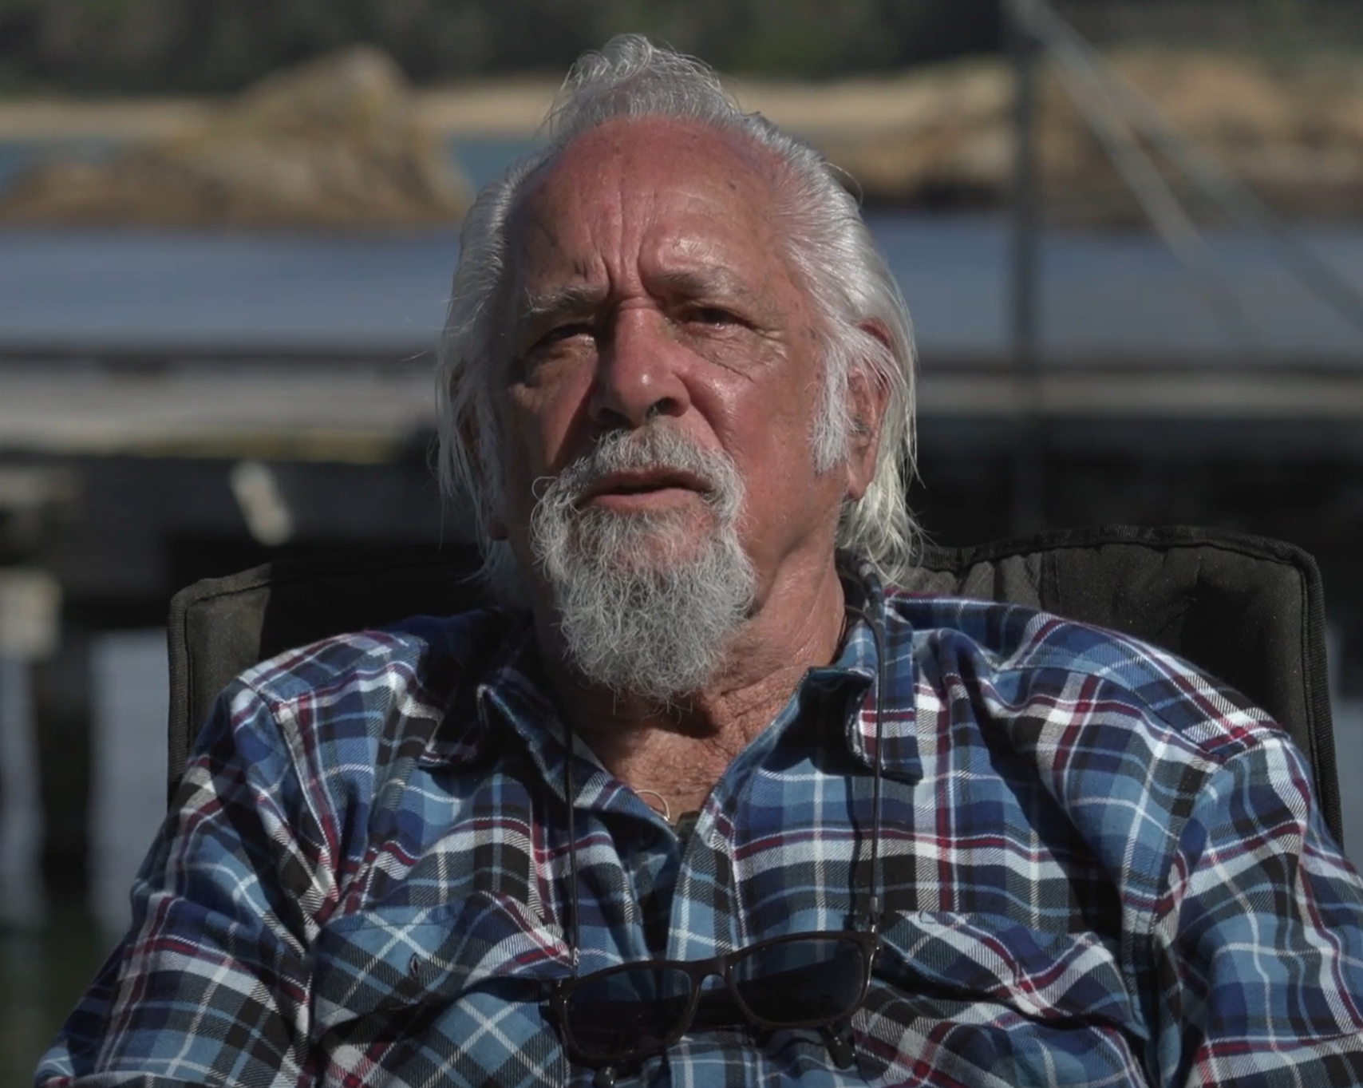
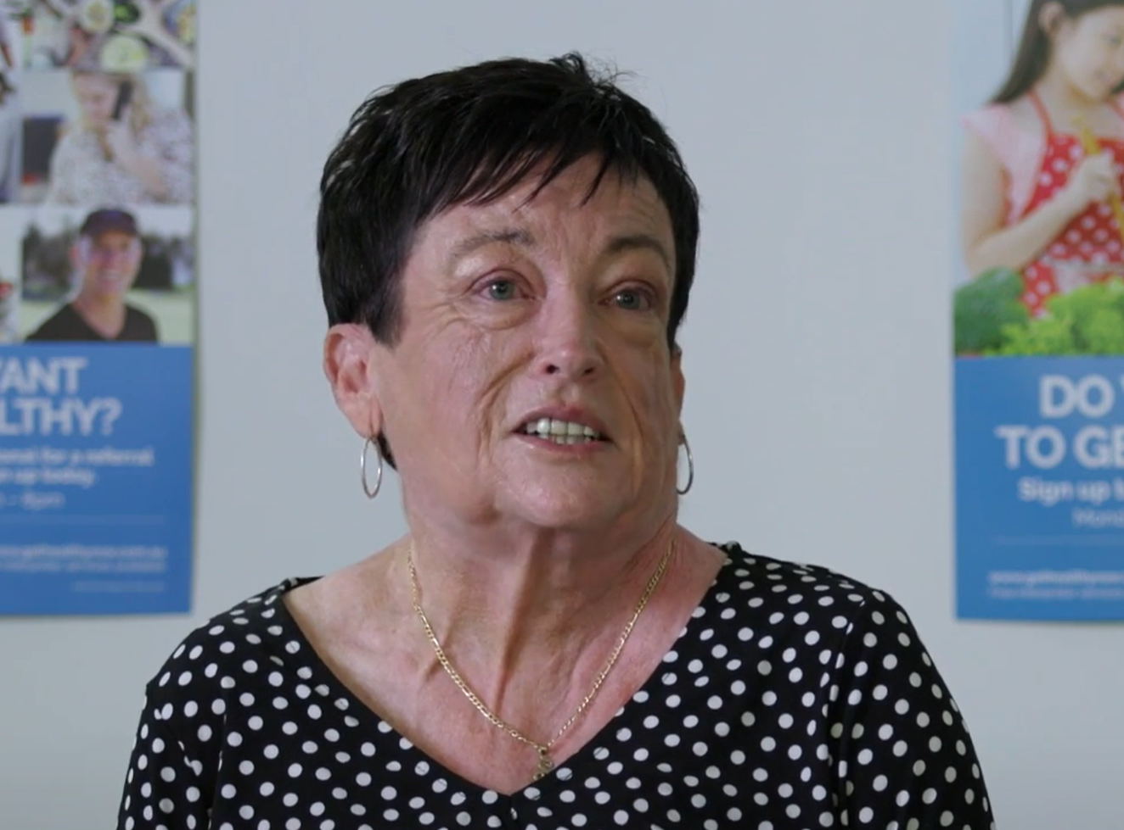
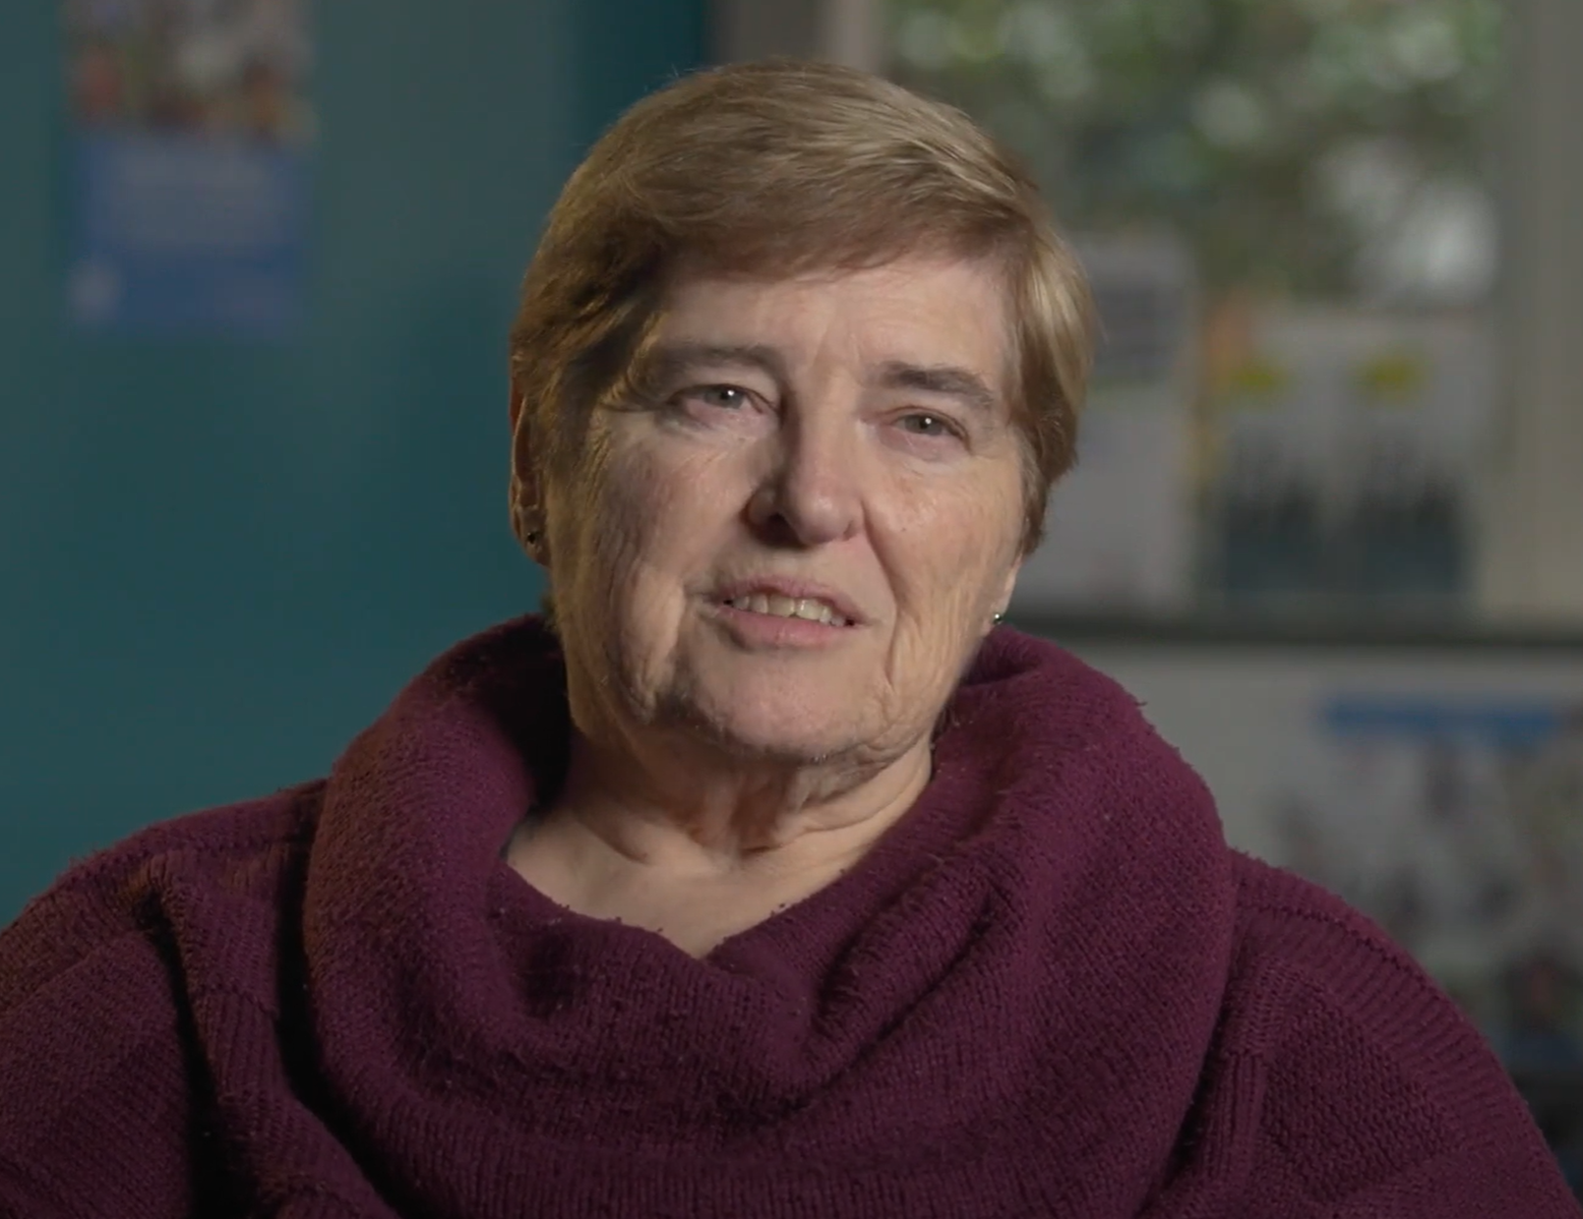
Experiences with Get Healthy Service
“
“
“
I think most of our mob should join because they get all the support from the Aboriginal health coaches to help them with their goals.
The Get Healthy Service has helped my mind and my body. It’s getting me up every day, going for a walk. I feel fitter. I feel stronger. It’s giving me the energy to do things in the day that I don’t normally do.
During our time on Get Healthy we’ve been learning how to control my husband’s diabetes better. I like working with my health coach because he helps me a lot… by not talking at me or to me. He talks with me.
”
”
”
Uncle Ossie
Sharon
Judith

Slide 14
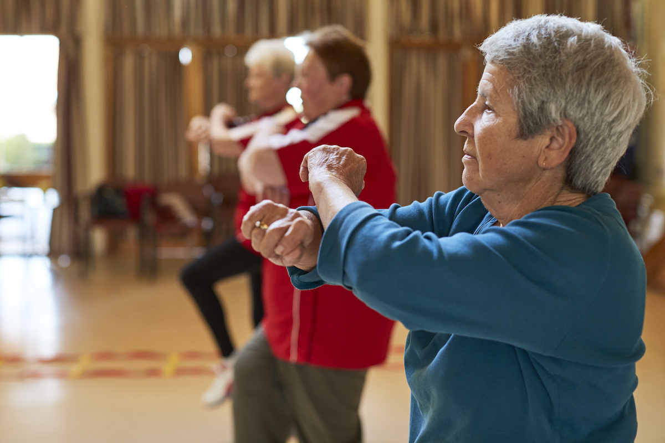

Stepping On
Learn how to reduce your risk of falling and how to maintain your independence.
Stepping On is a Falls Prevention program for people who are living at home and have experienced a fall or are concerned about falling.
This 7-week program is for adults aged 65 years and older and Aboriginal adults aged 45 years and older.
Each weekly 2-hour group session includes:
Find your local Stepping On program
​Educational talks from experts
Gentle exercises to improve your balance
Handouts and an exercise manual
NSW Health
© Clemson and Swann 2019​
Notes:
Note: This slide won’t be relevant for all LHDs – LHDs are to update/amend this slide to showcase local programs/services relevant to your LHD, which may include Stepping On.

Slide 15

Healthy Ageing Online learning guide
Free support for community organisations and groups
A free resource that can help you:
Lead sessions to support your members to complete the exercise circuits as a group
Support your members or clients make healthy changes
Provide accessible support to your clients and patients from the comfort of their own home
Encourage older people to learn ways to eat healthily, get active and stay independent.
I couldn’t recommend it enough. [There are] easier and harder exercises and no equipment needed. It’s been great.”
Download the free learning guide: www.activeandhealthy.nsw.gov.au/active-living/healthy-ageing-resources
NSW Health
Notes:
Key points:
The guide is designed for group leaders to embed the modules and circuits in a number of different environments depending on the community setting – group based learning or independent learning and come together to do the exercises.
Exercise providers can also include healthy ageing education into their sessions for free or refer their participants to the online learning to support maintenance of health behaviour change.

Slide 16
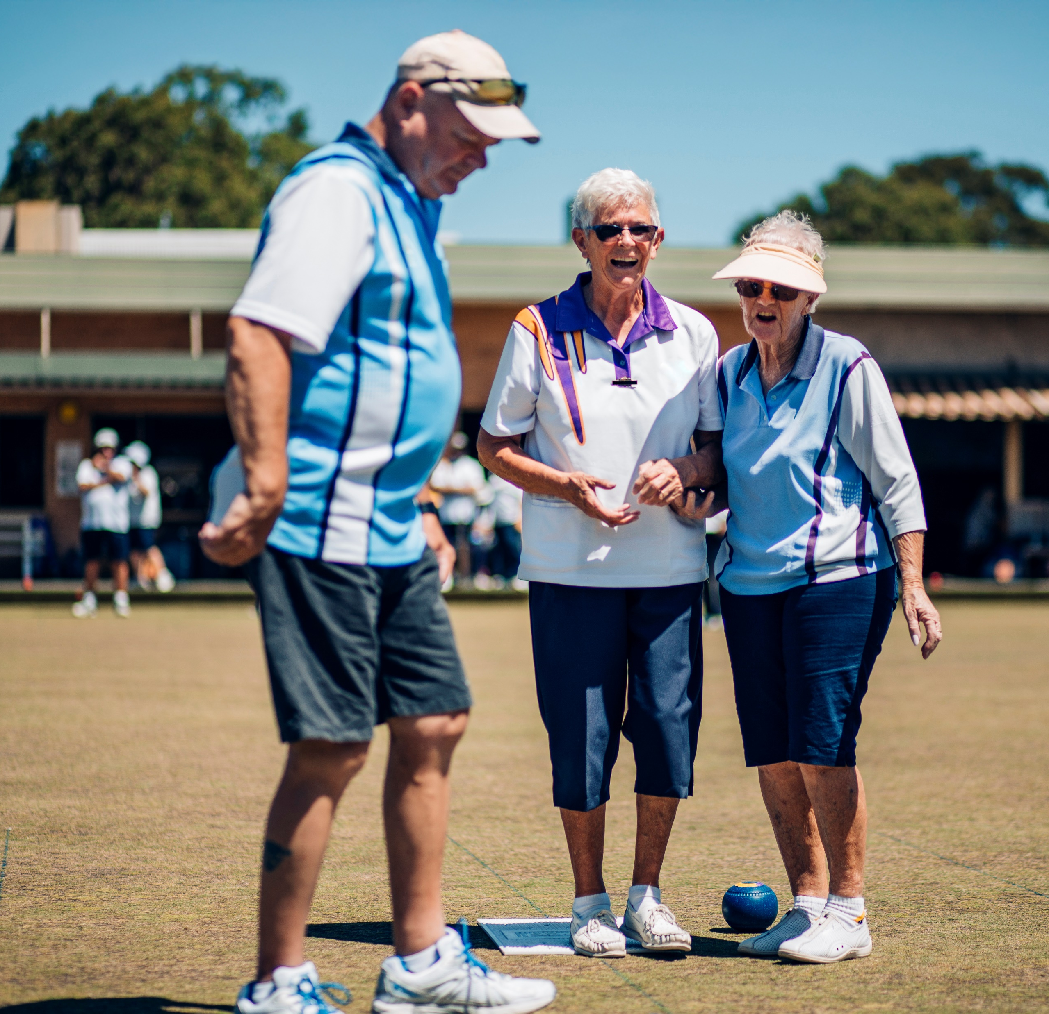
Active and Healthy Directory – list for free
Join an established network of physical activity and falls prevention programs across NSW
Exercise providers can list their over 50s programs on the Active and Healthy Directory.
Reach more people locally
Gain direct referrals from health professionals, including GPs, allied health and local health services
Be seen online anytime, at no cost
Quick and easy set up
Tap into trusted government promotion and targeted local marketing.

Slide 17
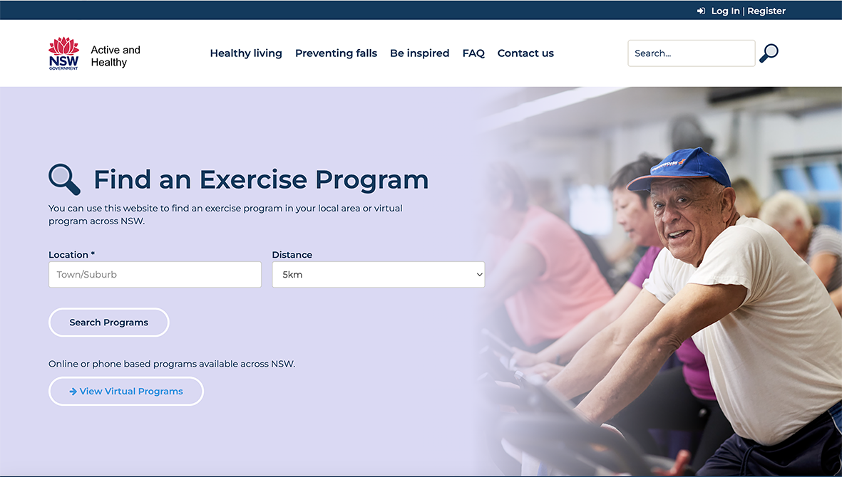
How to list your exercise program
Add your exercise program to the Active and Healthy directory in two easy steps:
Visit the Active and Healthy website to register an account
1
Once registered, you can submit your program details to appear on the Active and Healthy Directory
2
Register your exercise program today:
activeandhealthy.nsw.gov.au

Slide 18

Programs are registered as either a general physical activity program or a falls prevention program
Eligibility criteria for general physical activity programs
Eligibility criteria for falls prevention programs
It must be a program within NSW
It must offer non-contact activities, or sports that are modified for older adults
It must cater for people aged 50 years and older
Programs must be run by trained leaders, some examples include:
It must meet the first 3 criteria listed on the left and be run by a qualified exercise leader or health professional.
It must also meet the additional criteria below:
Specific balance challenging exercises
Class time – at least 40% of the class should be spent doing balance exercises
Exercise physiologist
Physiotherapist
Occupational therapist
Fitness leader – certificate III, IV, registered or accredited
Registered yoga instructor
Tai Chi leader
Dance instructor
Sports teacher
Coach
Registered LHD physical activity volunteer
Volunteer leader/trainer
The eligibility criteria for falls prevention programs were established in consultation with NSW falls prevention experts. Last updated September 2024.
NSW Health
Eligibility criteria & FAQs: www.activeandhealthy.nsw.gov.au/information-for-exercise-providers
Notes:
The purpose of this slide was to explain to exercise providers the two types of exercise classes that they can register on the directory. Also acknowledges to exercise providers that their exercise program is eligible for the A&H directory. Provides validation to exercise providers on the appropriateness of their classes

Slide 19
How to navigate the Active and Healthy Directory
Notes:
Youtube link: https://www.youtube.com/watch?v=R1zj3wBByJA

Slide 20
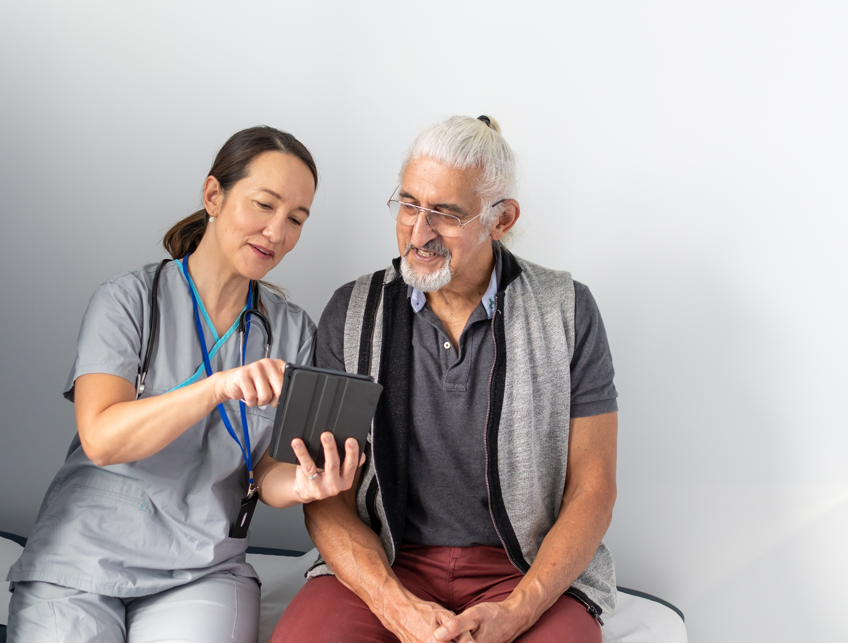
Free health coaching for older adults
Support that complements your care
The Get Healthy Service is a free, phone and online-based health coaching program that supports people over 16 in NSW to eat well, stay active, and improve their health and wellbeing.
Why refer your older patients?
Helps to reduce and monitor the risk of falls
Manage and lower risks of diabetes and other chronic diseases
Support during and after cancer treatment
Relevant and practical information for older adults
Simple referral and follow up service to complement your care.

Slide 21









Help your patients eat well, keep moving
and stay independent
The Get Healthy Service:
Provides encouragement and builds confidence​
Has easy access: Phone and online calls enable patients to participate from home. They can also receive printed materials to stay on track.​
Offers respective, inclusive and culturally aware support. Aboriginal Health Coaches, bi-lingual health coaches, interpreter services and National Relay Service.​
Online learning topics for
older adults
Exercise
videos
Screening
HBA1c, BP, AUSDRISK,
AUDIT C,
falls risk, smoking and vaping
Health coaching and self-directed learning
Simple referral and follow up process
Refer online at gethealthynsw.com.au/refer or via medical software (Medical Director and Best Practice)
Patients are contacted, receive a registration call, and are booked to speak with a health coach
Ongoing reports available for GP management
Phone,
video calls, online chat
SMS and
email
support
Self-service information, resources and appointment setting

Slide 22




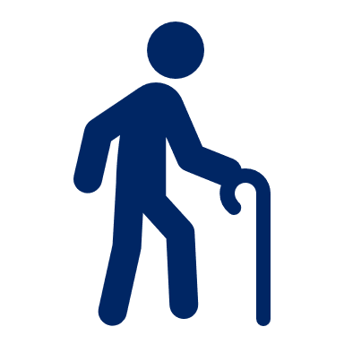

Setting the scene: Ageing and health
Australians are living longer, but the proportion of life spent in full health is not improving in parallel.
58%
of adults 75 or older are physically inactive.
80%
of adults aged 65+ live with at least one chronic health condition. Older adults account for 42% of hospitalisations.
1 in 3
older adults fall each year. Fall-related injury is the single largest cause of hospital presentations.
50%
of older adults are either at risk of malnutrition or are malnourished.
75+ years
Poorer health outcomes for those aged over 75 and priority population groups.
66%
of adults 65-74 are overweight or obese and 60% of adults 75 or older.
Declines in health and function can be linked to reduced physical activity and chronic disease, rather than true physiological ageing.​

Slide 23







Healthy ageing as a priority
More years in life, more health in those years
Physical activity
Healthy eating
Physical activity helps to maintain independence, maintain muscle mass, reduce risk of frailty and falls, improve sleep and mental health and maintain a healthy weight.
Greatest benefits of physical activity are achieved by those who are sedentary.
Healthy eating helps to maintain a healthy weight, reduce risk of malnutrition, osteoporosis and bowel cancer.​
A nutrient and protein rich diet is important as we age.
Recommendations: 30 minutes of moderate intensity physical activity on most, preferably all days. Including exercises for:
Fitness
Strength
Flexibility
Balance
Activities should be easy to fit into everyday life.
Recommendations: eating a healthy, balanced diet
and increasing:
Protein (eggs and lean meat)
Calcium (dairy)
Vitamin D (sunshine)
Importance of fibre (wholegrains).

Slide 24
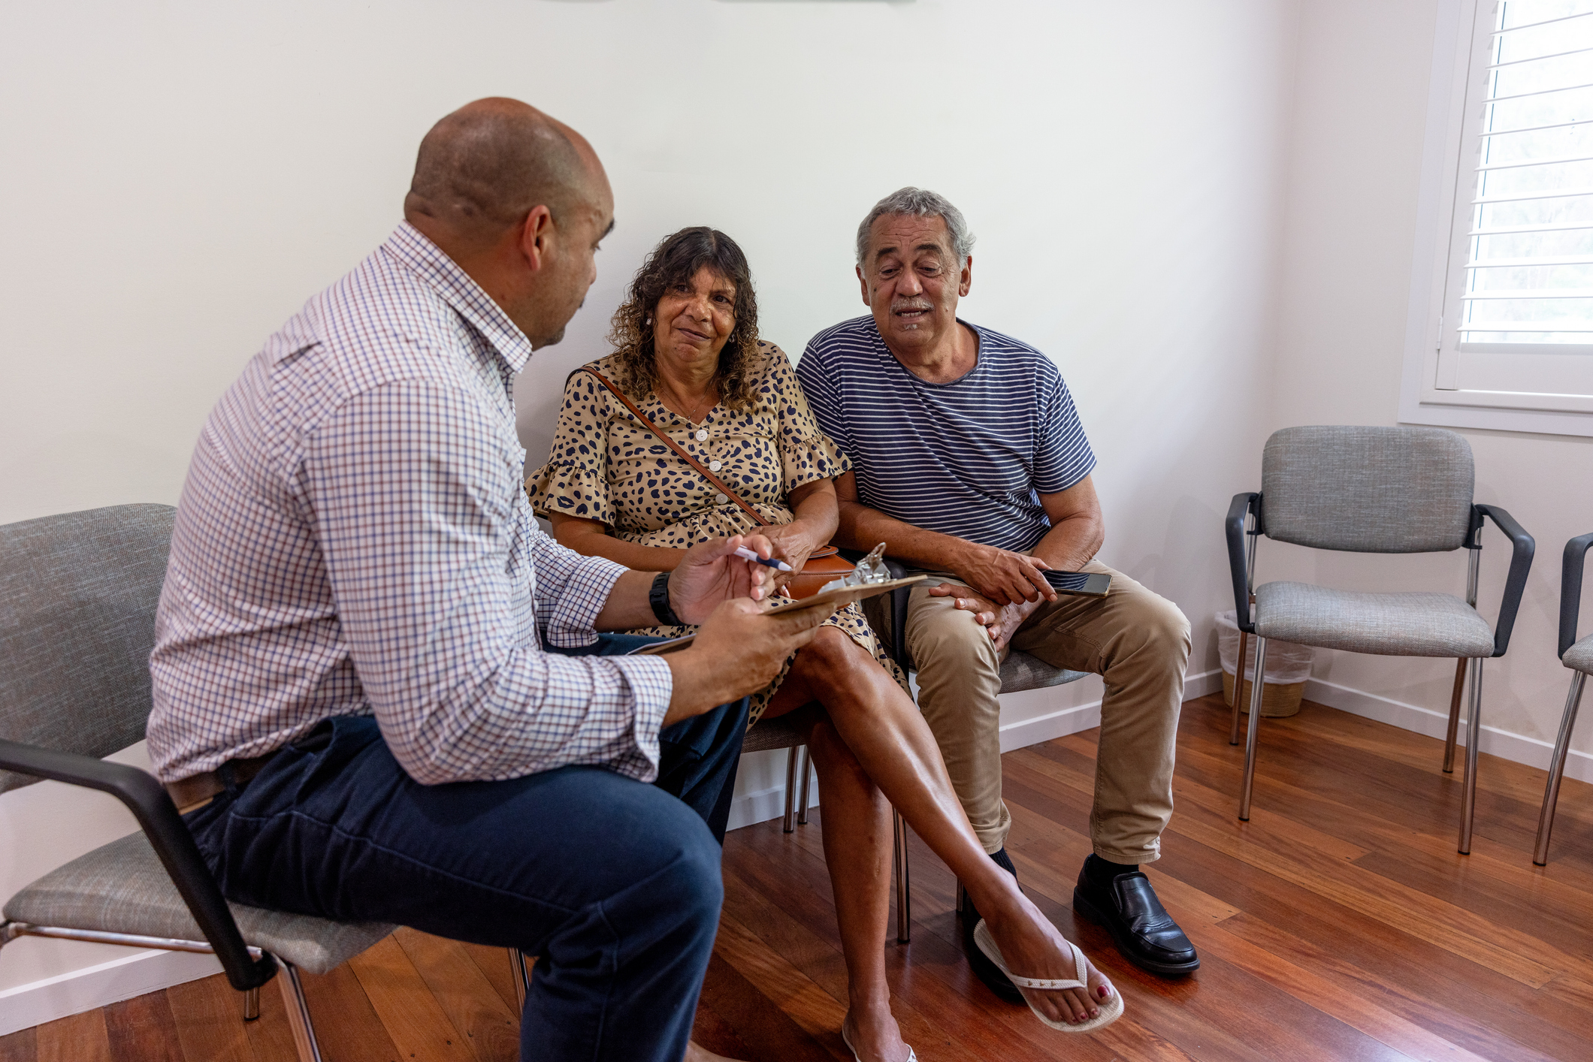

Referring to free healthy ageing support
Active and Healthy
Get Healthy Service
Healthy ageing online learning
Health coaching
Fact sheets and exercise manual
Refer online at:
gethealthynsw.com.au/refer
Or via electronic medical record (eMR) or other medical software
Exercise directory
Visit the website: activeandhealthy.nsw.gov.au
Notes:
Last slide

