Slide 1
Be more active to prevent cancer Multicultural Health Week 2023 Celebrate culture through movement – every move counts
Notes:
[This PowerPoint presentation is designed by the Cancer Institute NSW to be used by Multicultural Grant recipients and anyone celebration Multicultural Health Week 2023.
The information is about cancer prevention and physical activity.
We hope you enjoy celebrating culture through movement with your community.}

Slide 2
Acknowledgement of Country
I acknowledge the Traditional Custodians of the lands on which we work and live, and recognise their continuing connection to land, water and community. I pay my respects to Elders past and present.
Artwork by D.Golding 2016

Slide 3
Healthy changes to reduce cancer risk
Notes:
[Play video – make sure you turn on sound if sharing your screen to present]
Facilitator notes:
Being active is one of 6 key ways to reduce your risk of cancer.
The other ways are quitting smoking, drinking no or less alcohol, eating healthy. Maintaining a healthy weight and protecting your skin form UV radiation from the sun.
Healthier habits including physical activity can also protect you against diabetes, heart disease, stroke and other illness.
What you and your family eat, drink and do can increase or decrease the risk of cancer.

Slide 4
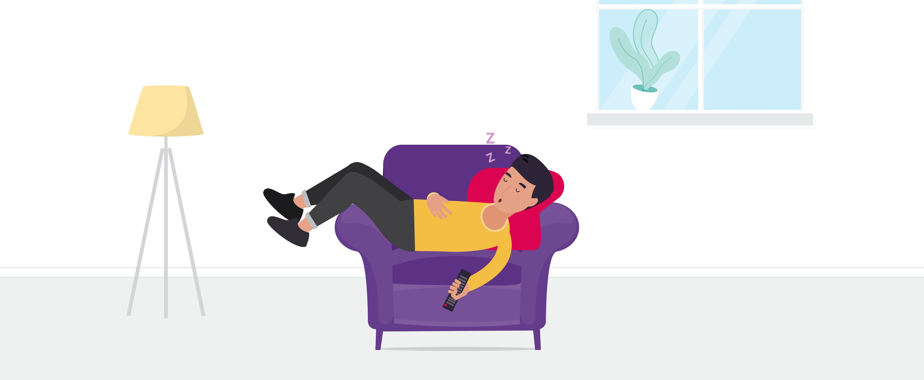
1 in 3 cancers can be prevented
Notes:
Facilitator notes:
Many people will be affected by cancer in their lifetime.
More than half of all Australians are not active enough.
Being inactive – not moving enough during the day is one of the top four biggest causes of cancer in Australia.
Sitting less and moving more cuts your risk of cancer.
Exercise reduces your risk of bowel, breast and endometrial cancer. It may also reduce your risk of oesophageal, lung and liver cancer.

Slide 5
What are the types of physical activity?
Notes:
Facilitator notes:
One hour of moderate activity (when your heart beats a bit faster) or 30 minutes or more vigorous exercise (makes your heart beat faster and you breathe more rapidly) is recommended every day.
Exercise moves waste and cancer-causing toxins out of your body more quickly.
Exercise also strengthens the immune system to prevent cancer cells growing.
Moving your body improves your mood, helping you feel better.
It’s okay to start with a small amount of activity and build up to more.
Get help from a health professional if you are starting vigorous exercise after a break.

Slide 6
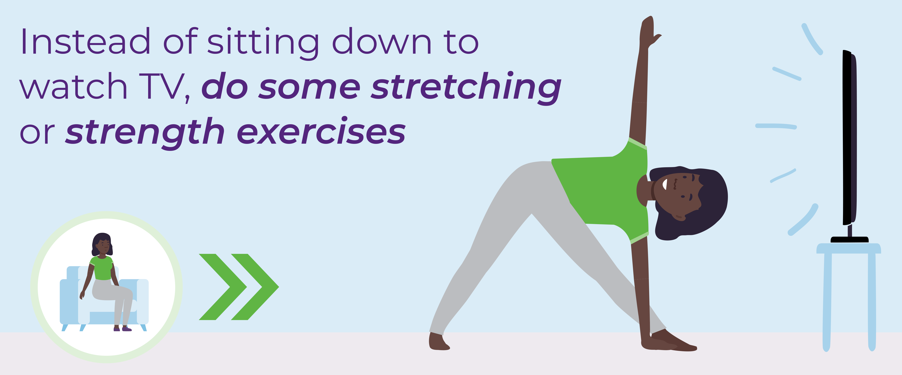
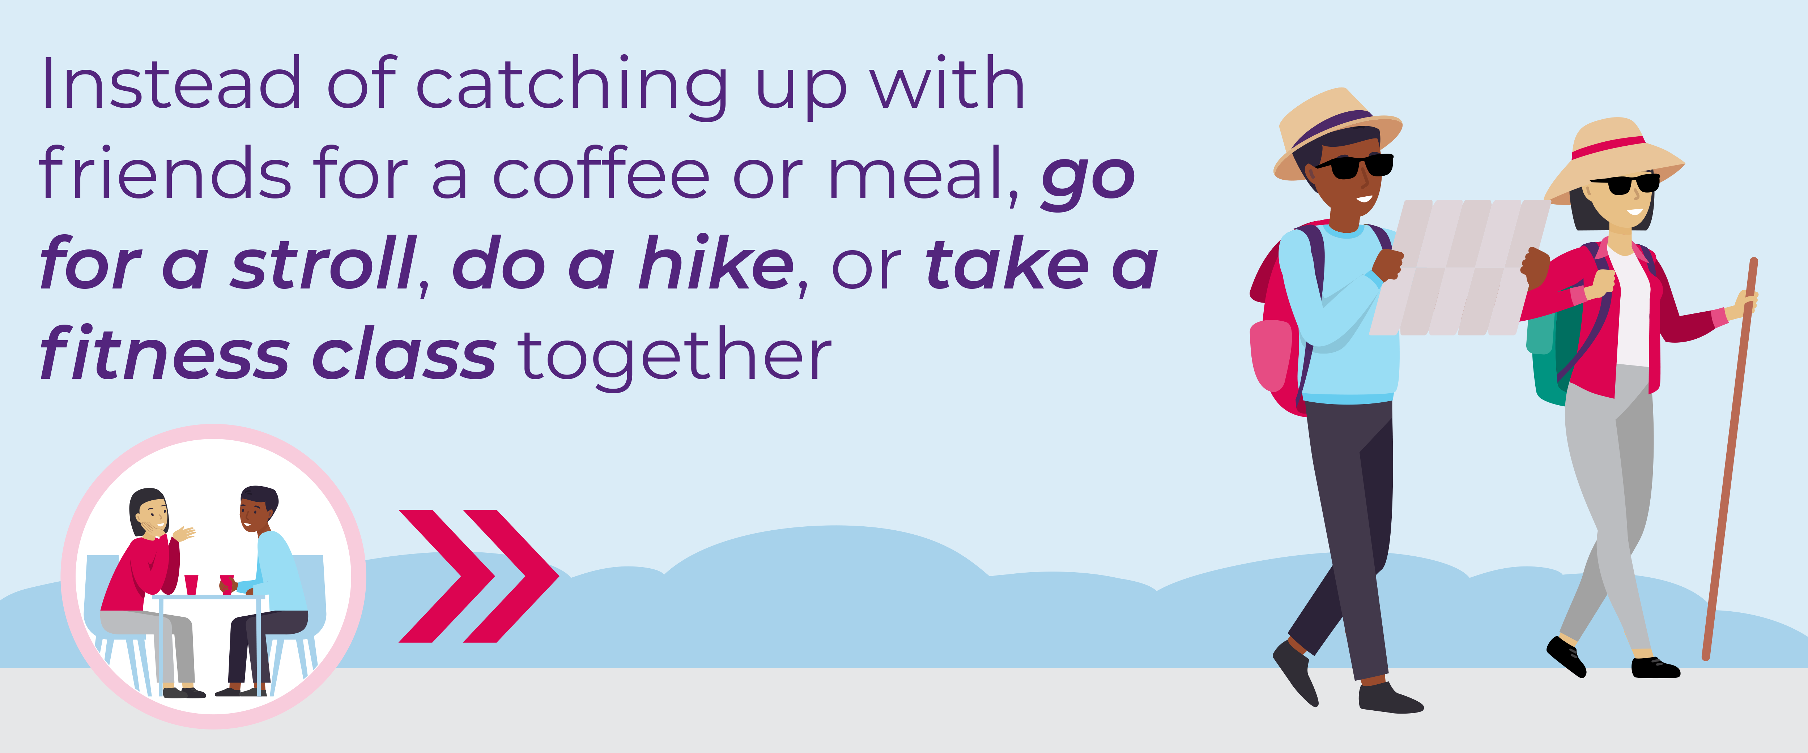
How can I get started?
Notes:
Facilitator notes:
There are many ways you can add more activity while you go about your day:
take the bus rather than driving
park further away from the shops
play with the kids rather than watching
mow the lawns
start a walking group.
Other ideas? See cancer.nsw.gov.au/be-more-active.

Slide 7
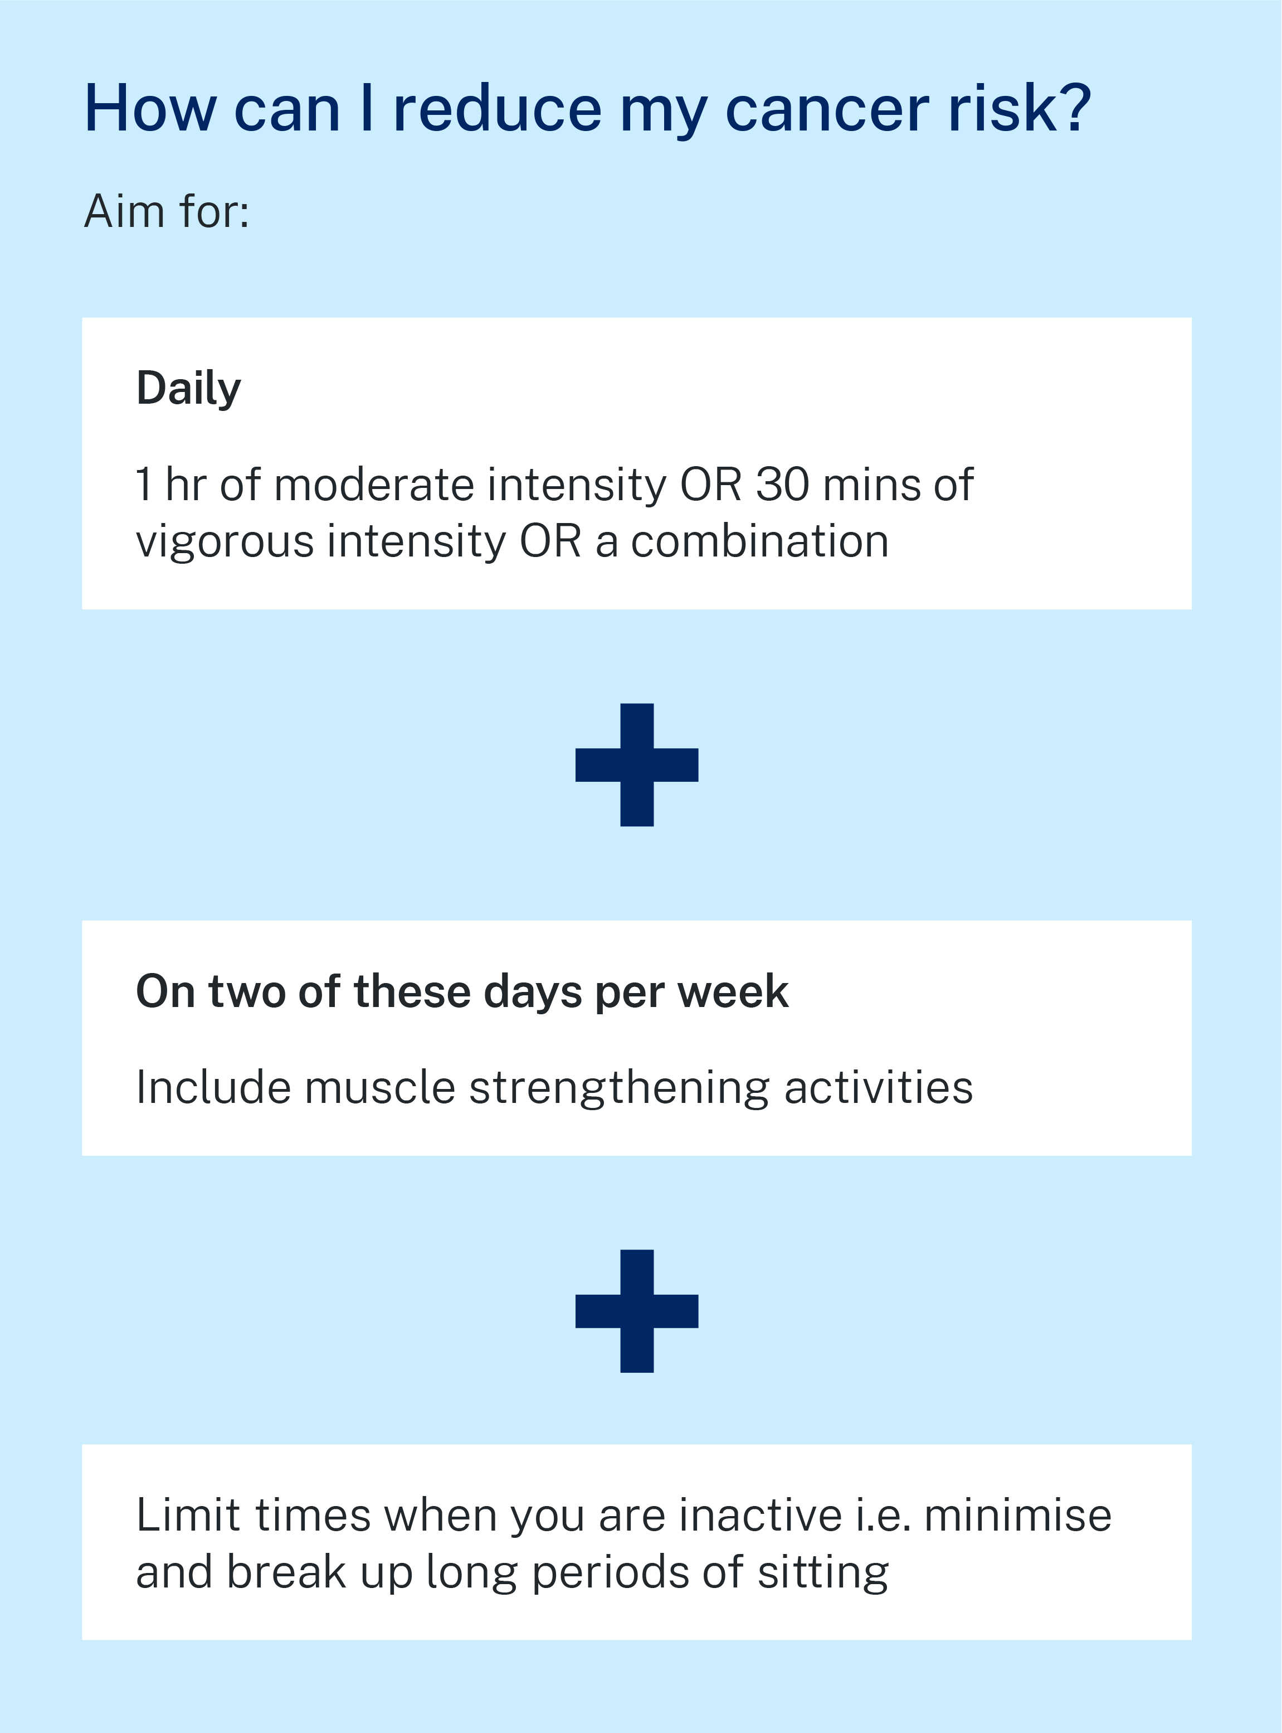
How much activity?
Notes:
Facilitator notes:
If you live in a healthy way there is less risk of cancer – but you may still get cancer.
This is why cancer screening is so important – to pick it up early.
If you live in a healthy way there is less chance of other diseases as well, like diabetes and heart disease.
Activity:
Do a simple activity with the group after the discussion.
Share a traditional dance or sport or take a 20-minute walk together outside

Slide 8
Where can I find groups and sports?
Office of Sport
Link: sport.nsw.gov.au/find-a-sport
For all
Not sure which activity to start with? The Office of Sport provides a list of many different sporting organisations in NSW to get involved with. You can also find specific sports and organisations for people with disability.
Active and Healthy
Link: activeandhealthy.nsw.gov.au/
For older adults
Active and Healthy provides information and tools for older adults and exercise professionals to increase their physical activity. Look for exercise and falls prevention classes in your area.
Local Council
Link: olg.nsw.gov.au/public/find-my-council/
For people seeking local culturally and linguistically relevant groups
Your local council may have information about community groups and local facilities to support your physical activity.
CanRevive
Link: canrevive.com/
For Chinese speaking community
CanRevive provides support for Chinese language speakers, and organise opportunities for exercise classes.
Notes:
Facilitator notes:
Here are some websites where you can find groups and sports
Find the Directory on https://www.cancer.nsw.gov.au/prevention-and-screening/preventing-cancer/reduce-your-cancer-risk/be-more-active
The Office of Sport site also has information in Arabic, Farsi and Dari on joining a sporting club. There is also information about Active Kids vouchers

Slide 9
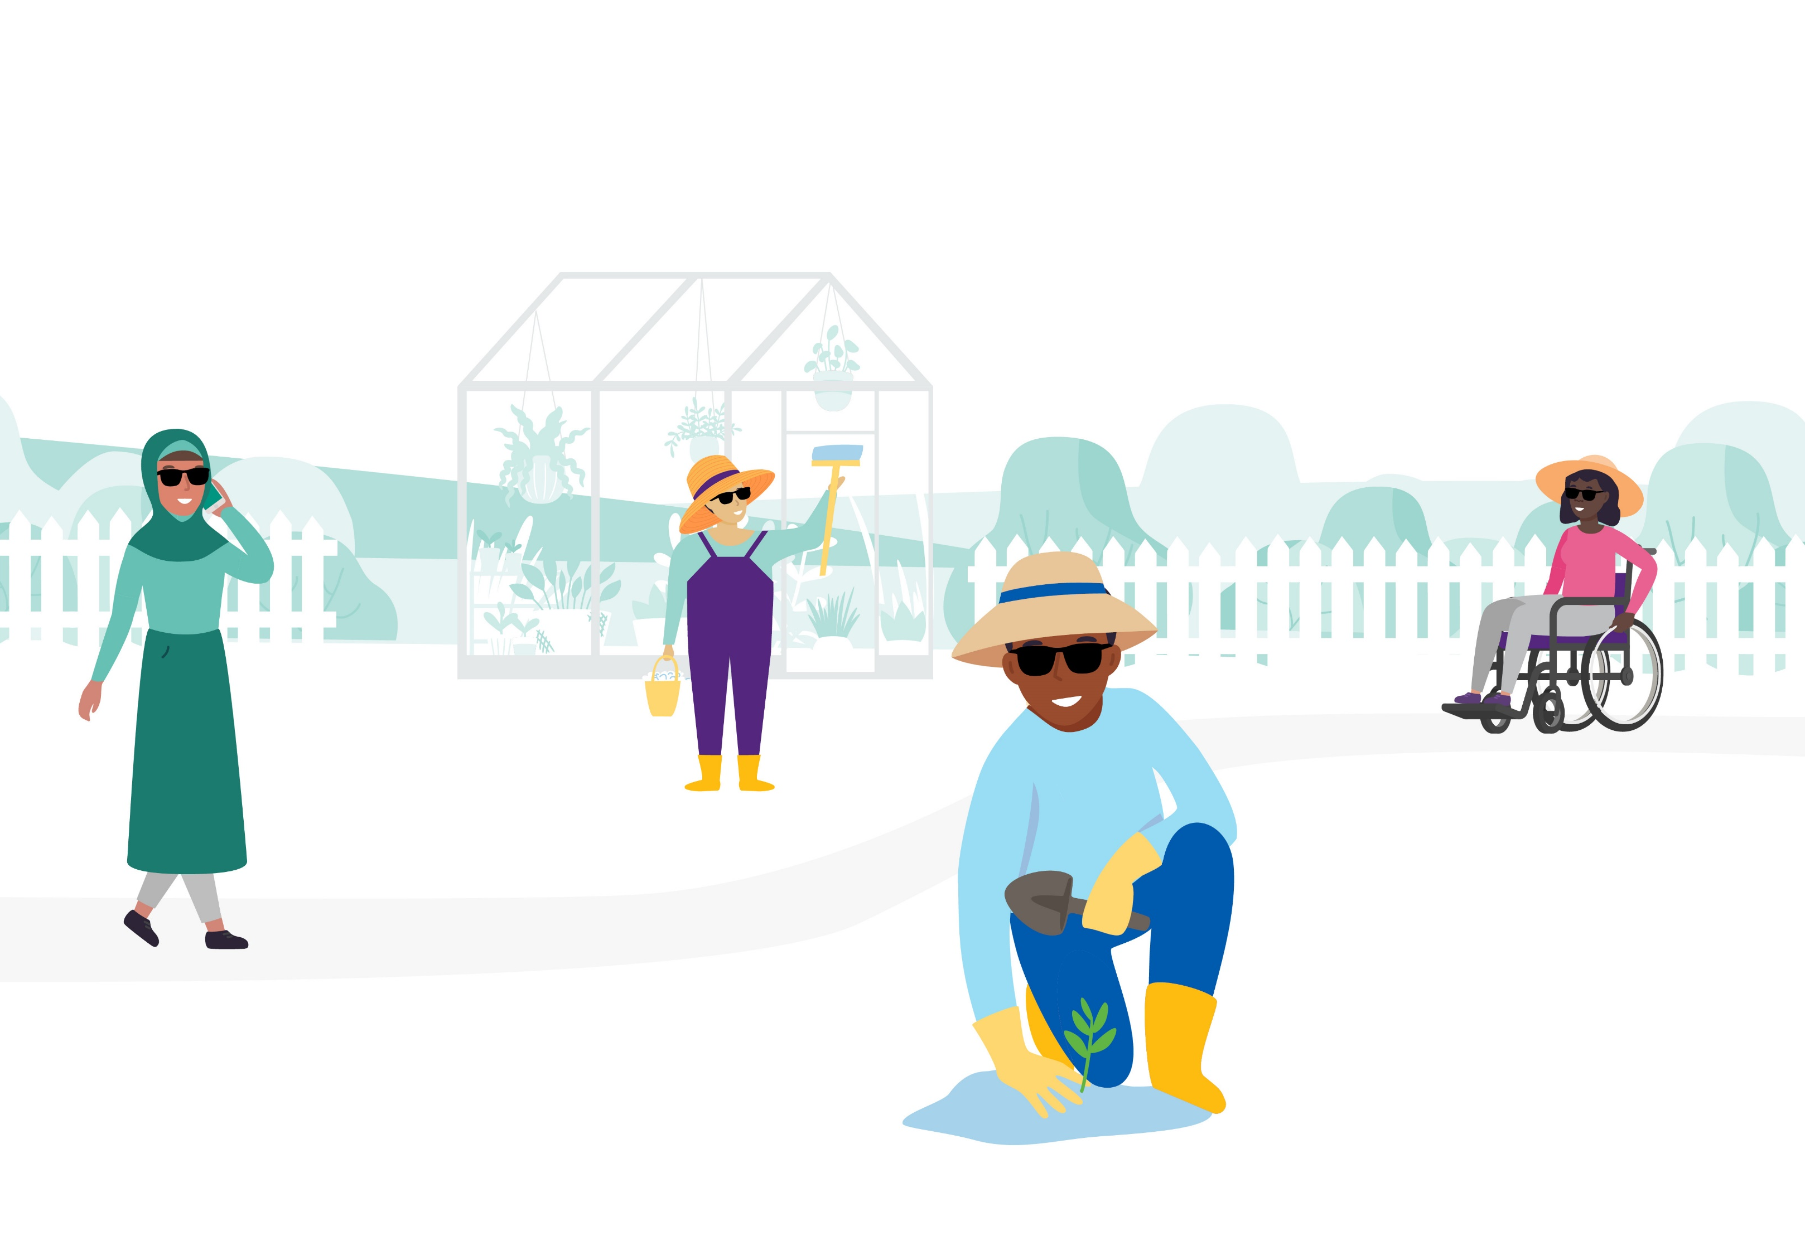
Can I get help to get started?
Get Healthy:
Link: gethealthynsw.com.au/program/
For all
Get Healthy is a personalised phone-based health coaching service that supports adults in making healthy lifestyle changes. Doctors and health professionals can provide referrals to this free service. There are dedicated programs including Aboriginal and Chinese coaching programs.
Notes:
Facilitator notes:
There is coaching support for people making healthy lifestyle changes from Get Healthy

Slide 10
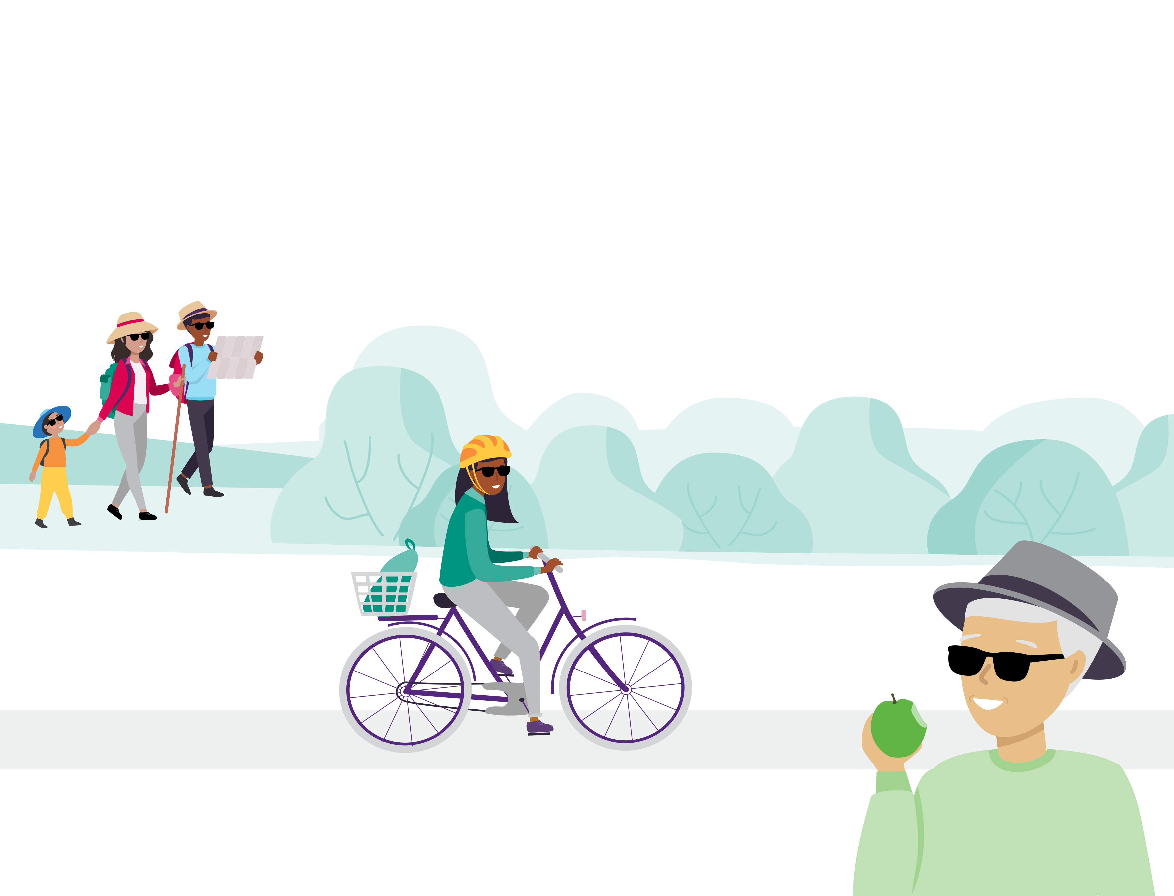
Every move counts! Have fun!
More information about Multicultural Health Week 2023 mhcs.health.nsw.gov.au/about-us/multicultural-health-week/2023
Access physical activity information in 18 languages in Staying well and preventing cancer flipcharts
Download and print our Be more active reduce your cancer risk factsheet (PDF) and worksheet on tips to help you get started with physical activity (PDF).
Notes:
Facilitator notes:
Access Staying well and preventing cancer flipcharts in 18 languages here https://www.cancer.nsw.gov.au/about-cancer/document-library/staying-well-and-preventing-cancer-community-educa (PPT or PDF) This resource also includes information on Healthy eating, Maintaining a healthy weight, Drinking less alcohol, Quitting smoking, and protecting skin from UV radiation.
Download and print our Be more active reduce your cancer risk factsheet (PDF).
Download and print our worksheet on tips to help you get started with physical activity (PDF).

